Slide 1
Massive MIMO Experiments
NSF PAWR POWDER Testbed
Bharath Keshavamurthy

Slide 2
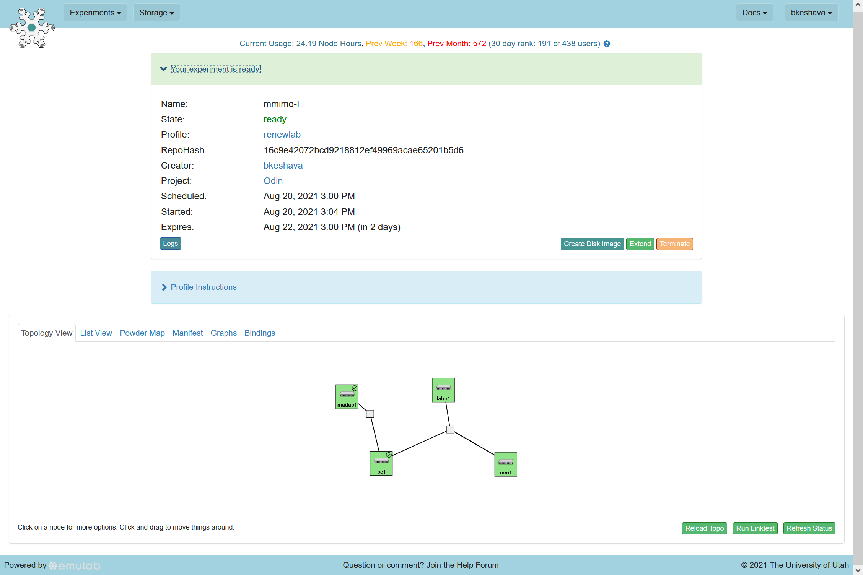
Experiment Topology: Anechoic Chamber
MATLAB block-store sliver for toolbox-based development
Iris clients (x2) inside the anechoic chamber
A 10 Gbps Ethernet link between the compute node and the Faros Hub at the mMIMO BS for SSH access and control; similar link for both Iris clients
Compute Node for SSH and CTRL operations
[Dell PowerEdge R840 at the Fort Douglas Datacenter]
Massive MIMO (mMIMO) Base Station (BS | 48 Tx/Rx chains) and Aggregation Hub inside the anechoic chamber

Slide 3
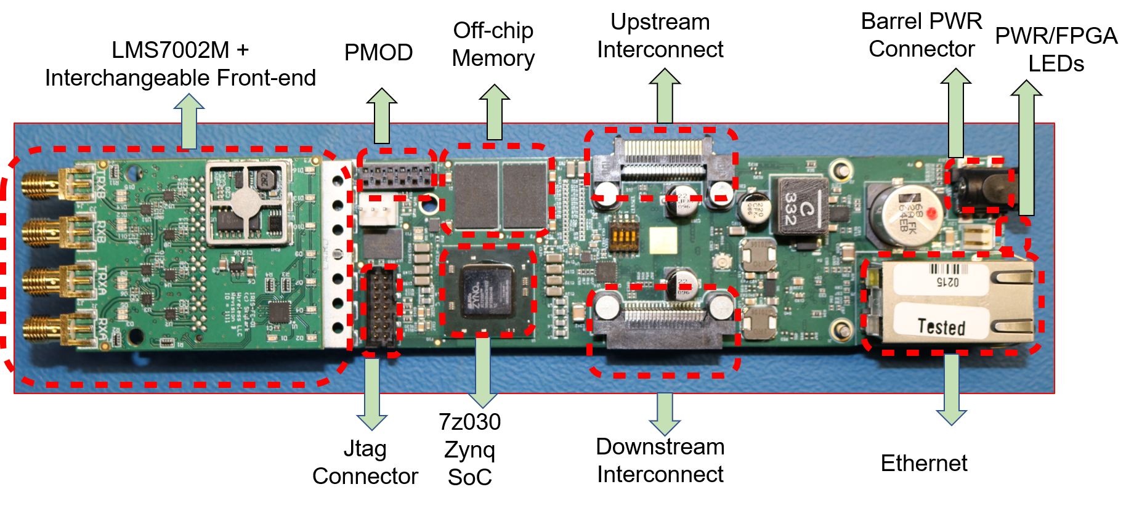
mMIMO Resources: Iris SDR Standalone Configuration: Client | Daisy-Chained Configuration: mMIMO BS (Source: RENEW)

Slide 4
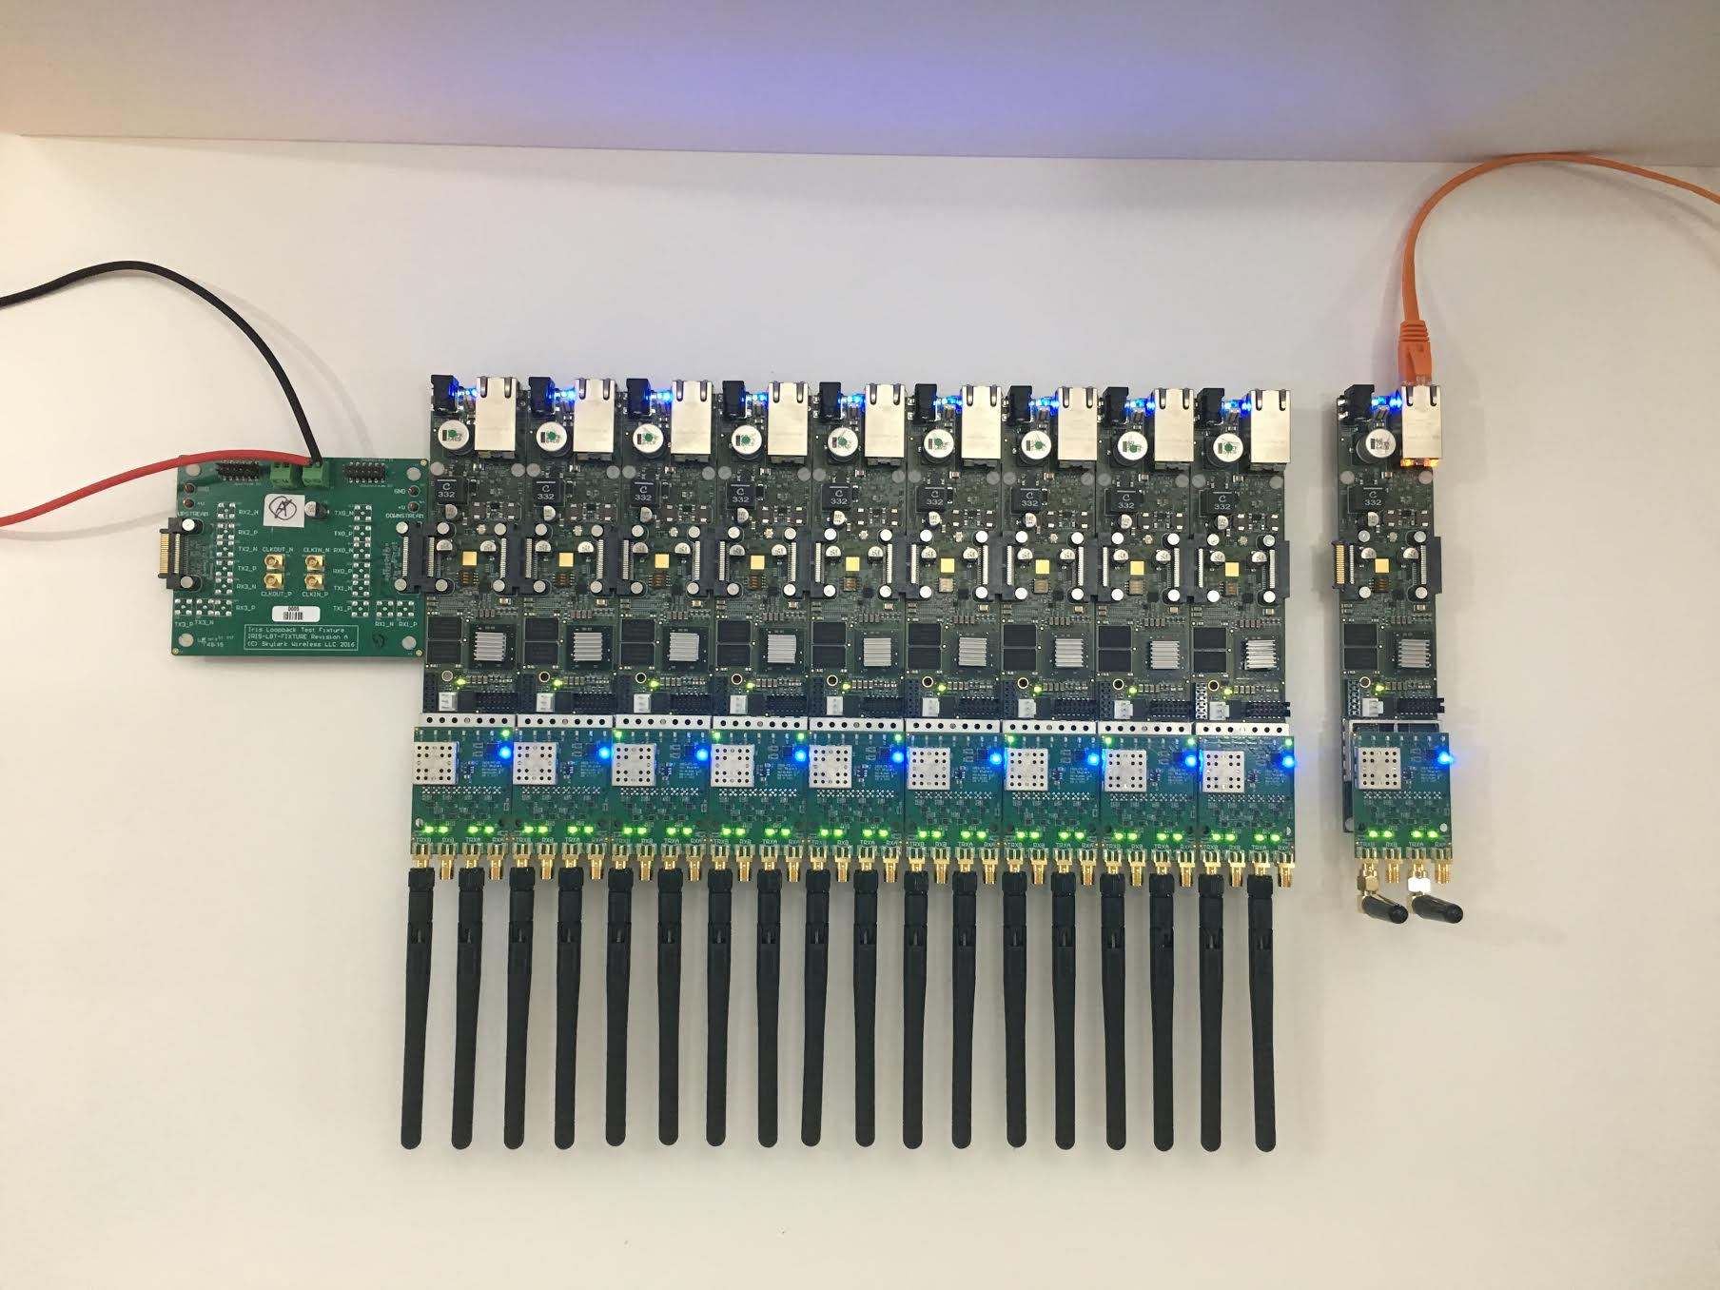
mMIMO Resources: Daisy-chained Iris SDRs at the BS (Source: RENEW)

Slide 5
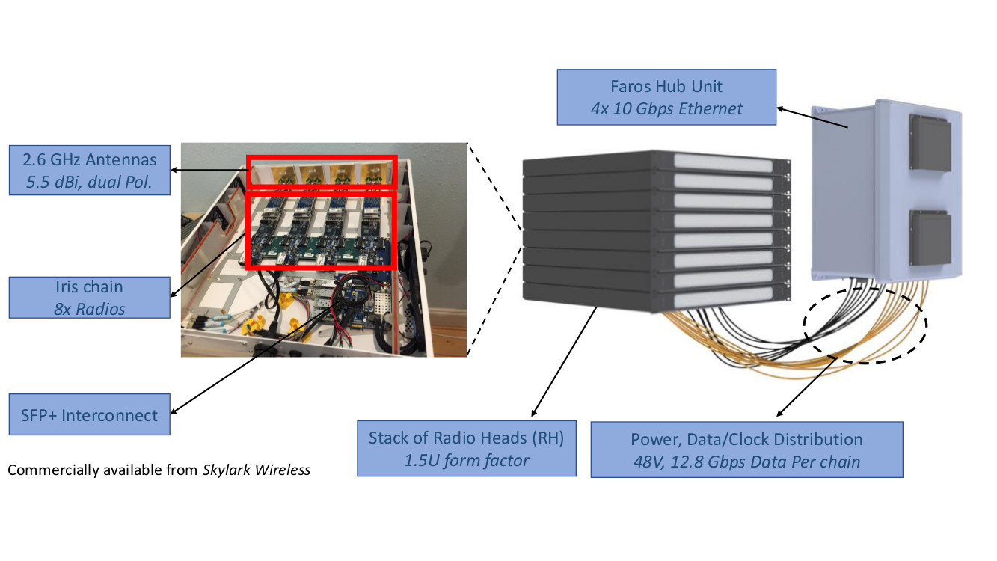
mMIMO Resources: Skylark/Faros BS with Aggregation Hub (Source: RENEW)
RRH (Remote Radio Head) – also abbreviated as RH (Radio Head) – is an enclosure of several daisy-chained SDRs (e.g., 4).
Several of these enclosures (e.g., 6) constitute a mMIMO BS.

Slide 6
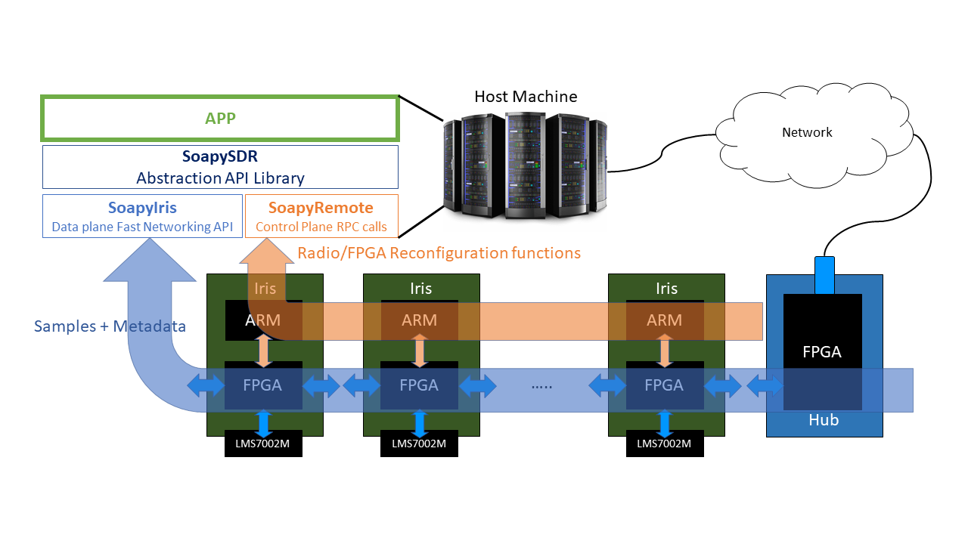
mMIMO Development Layers (Source: RENEW)

Slide 7
mMIMO Development Details
RENEWLab libraries, frameworks, and scripts:
Radio Node (SDR) Discovery
SoapySDR Middleware API for interfacing Python & MATLAB level control of the FPGA and ARM A9 processor within an Iris SDR
Python Beacon Beam-sweeping, TDD Framer, and SISO Tx/Rx scripts
C/C++ Sounder code – and its dependencies
Python visualization & analysis tools
Our development:
Compute node, Radio resource, and Frequency provisioning (Python | Rspec)
RENEWLab Configuration & Control (Python | Shell | JSON)
Modifications to Python-based visualization & analysis scripts (Python | Shell)
Yet to be tested:
MATLAB toolbox-based development (TDD Frame Scheduler, Tx/Rx of Pilot Sequences, Channel Estimation, Beamforming, Modulation/Demodulation, Equalization, and Visualizations)

Slide 8
LTE-signal SISO Tx/Rx at specific mMIMO BS SDRs

Slide 9
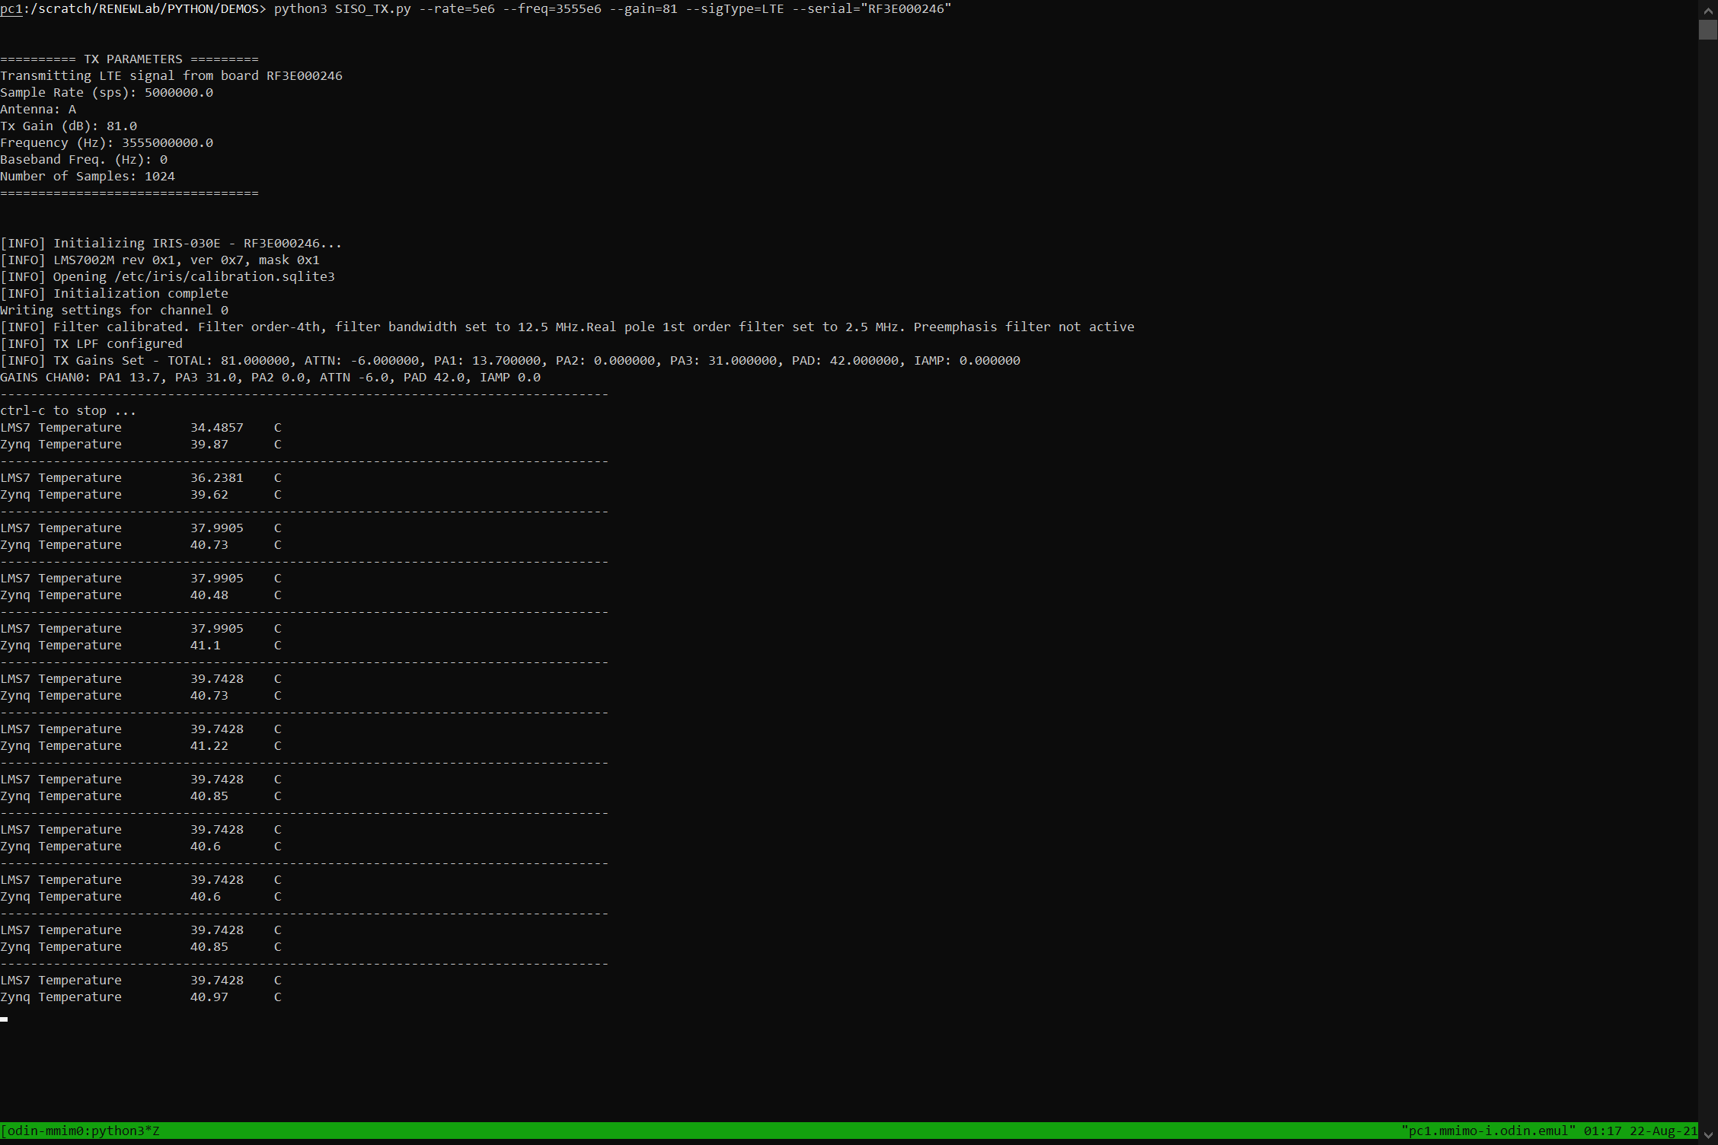
LTE-signal SISO Tx
Starting LTE-signal Tx operations at a specific BS SDR (RF3E000246) | Frequency = 3.555 GHz
RF3E000246 Channel-A Tx chain initialization and calibration

Slide 10
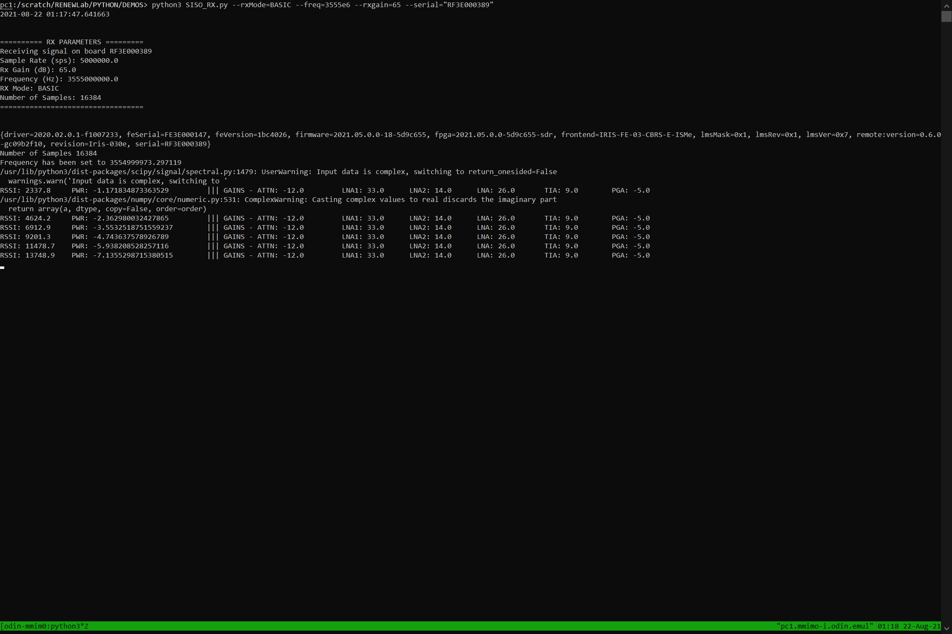
LTE-signal SISO Rx
Starting LTE-signal Rx operations at a specific BS SDR (RF3E000389) | Frequency = 3.555 GHz

Slide 11
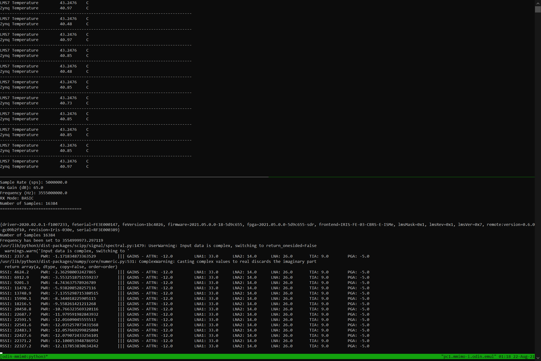
LTE-signal SISO Tx/Rx

Slide 12
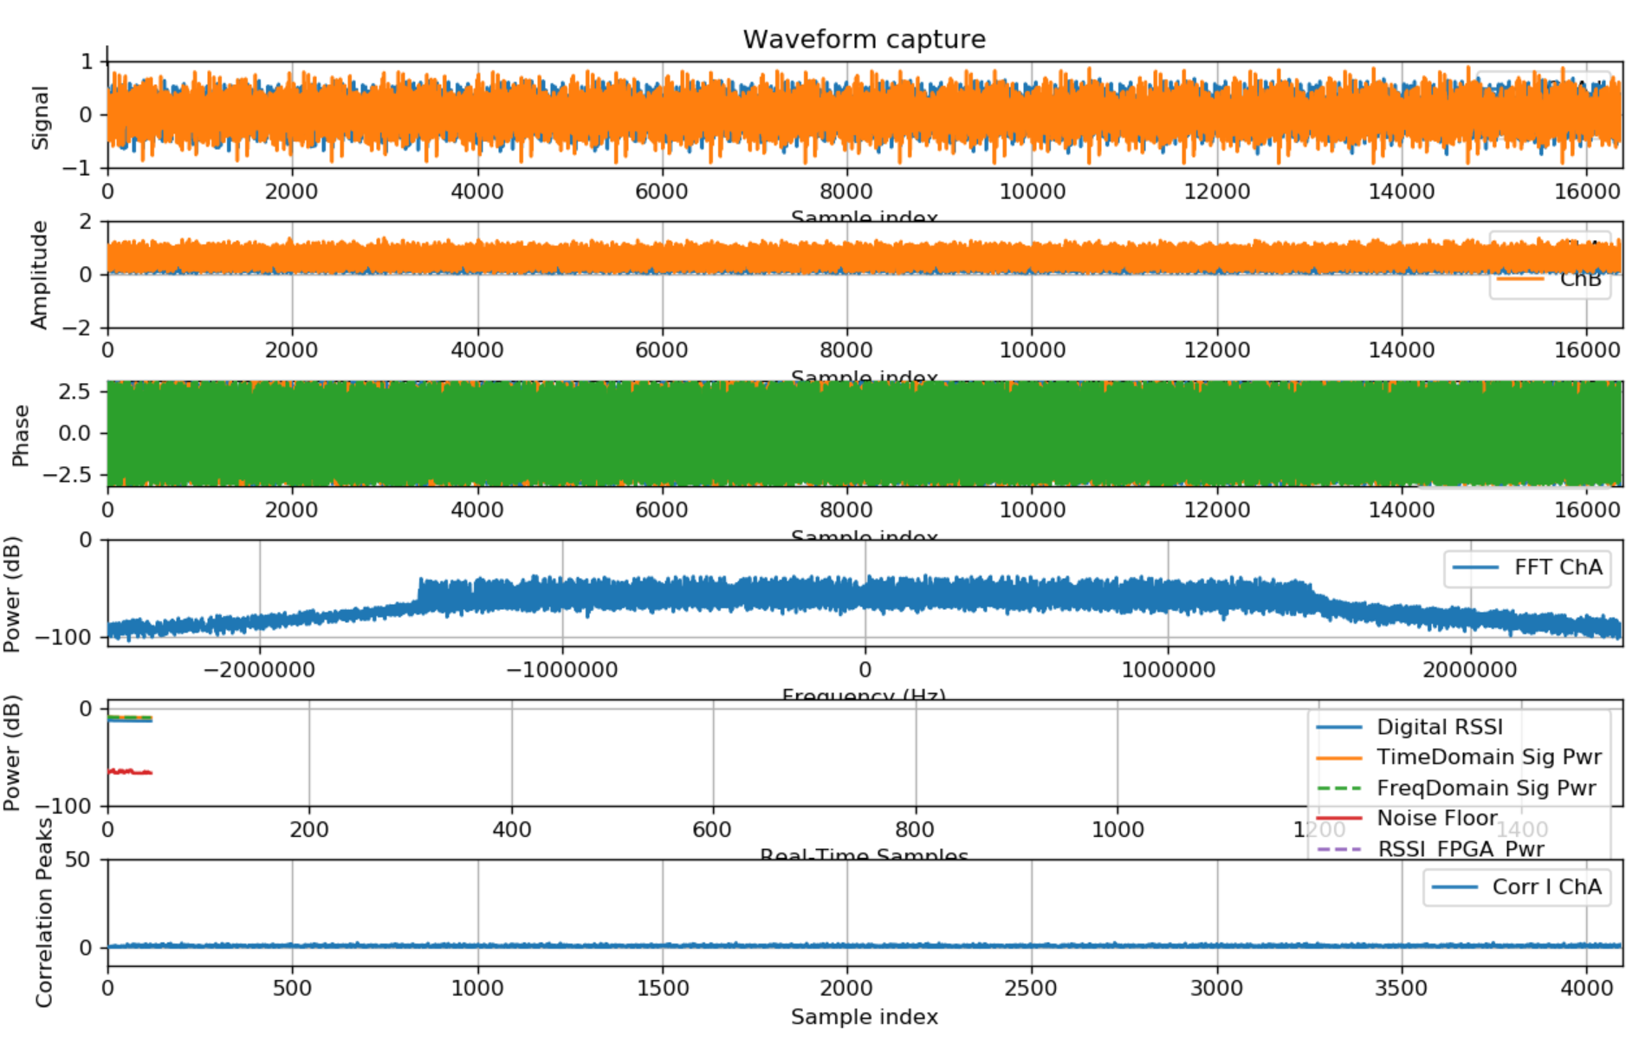
LTE-signal SISO Tx/Rx: Real-Time Visualizations

Slide 13
TDD Framer

Slide 14
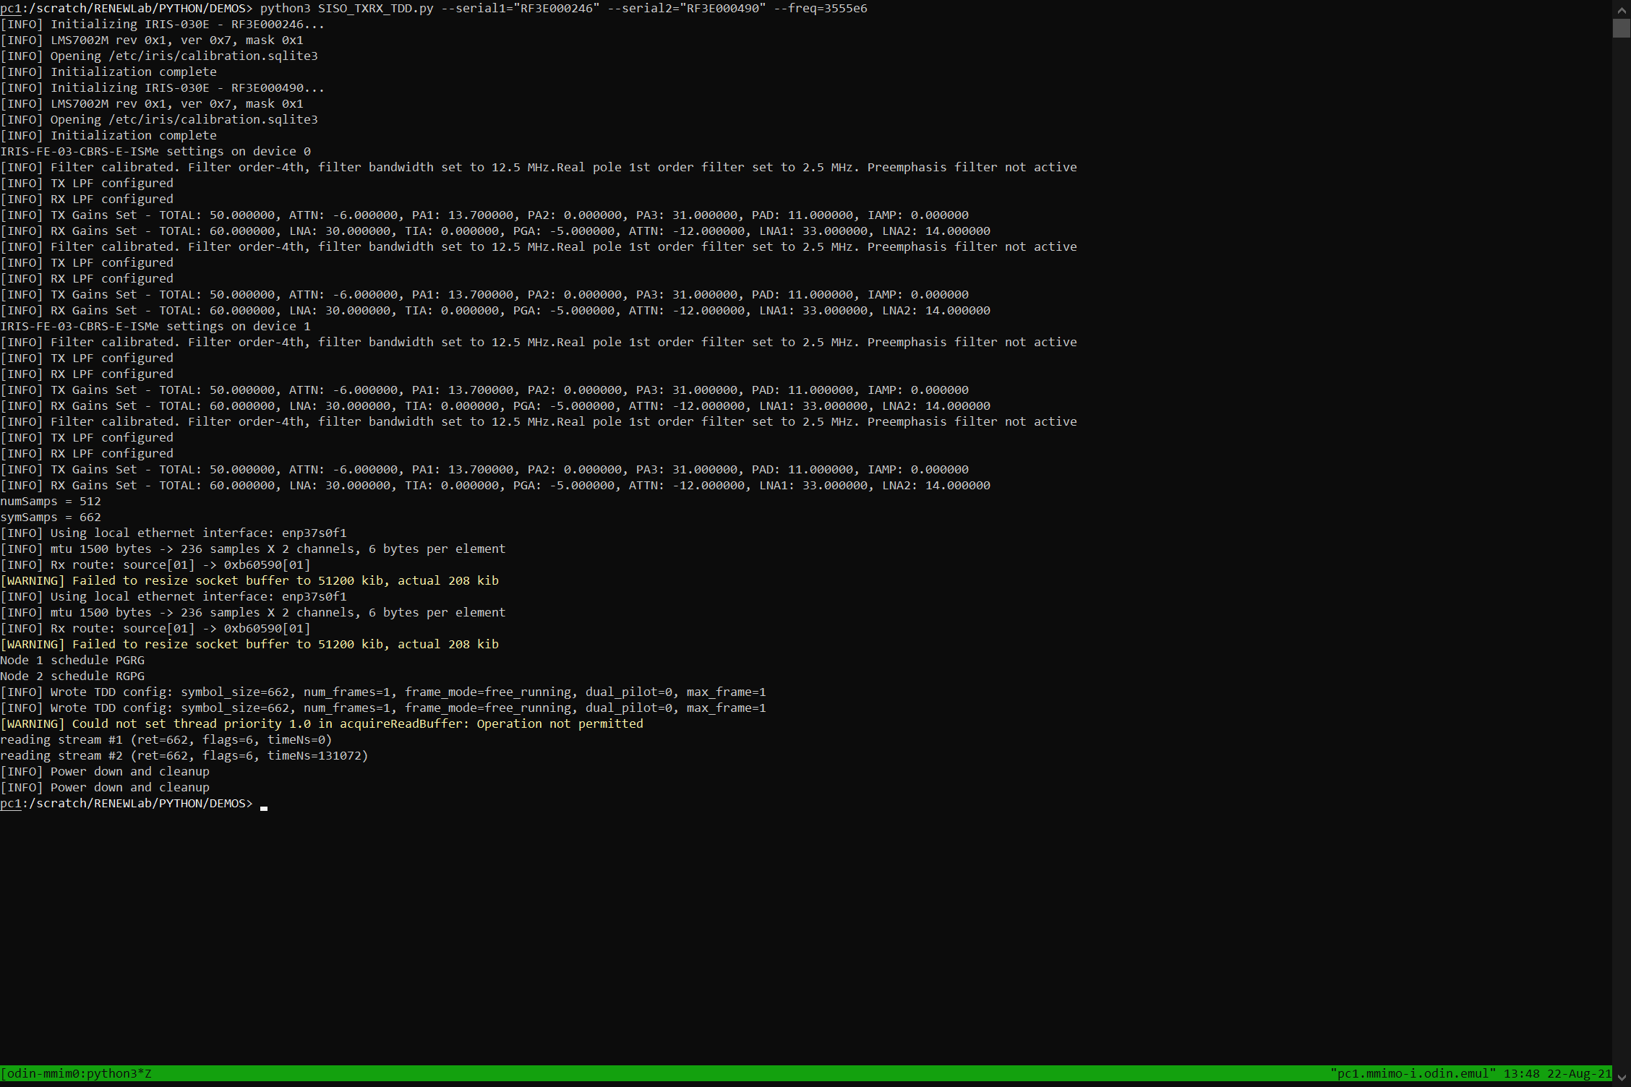
TDD Framer
Initializing specific provisioned BS SDRs: LMS7002M transceiver startup
SDR-1 | Serial # = RF3E000246
SDR-2 | Serial # = RF3E000490
Both SDRs are at the mMIMO BS
Tx/Rx frequency | CBRS spectrum | 3.555 GHz
Frame schedule: Sinusoid pilot signal sent from one SDR (‘P’) | Received at the other SDR (‘R’) | Guard intervals in-between (‘G’)

Slide 15
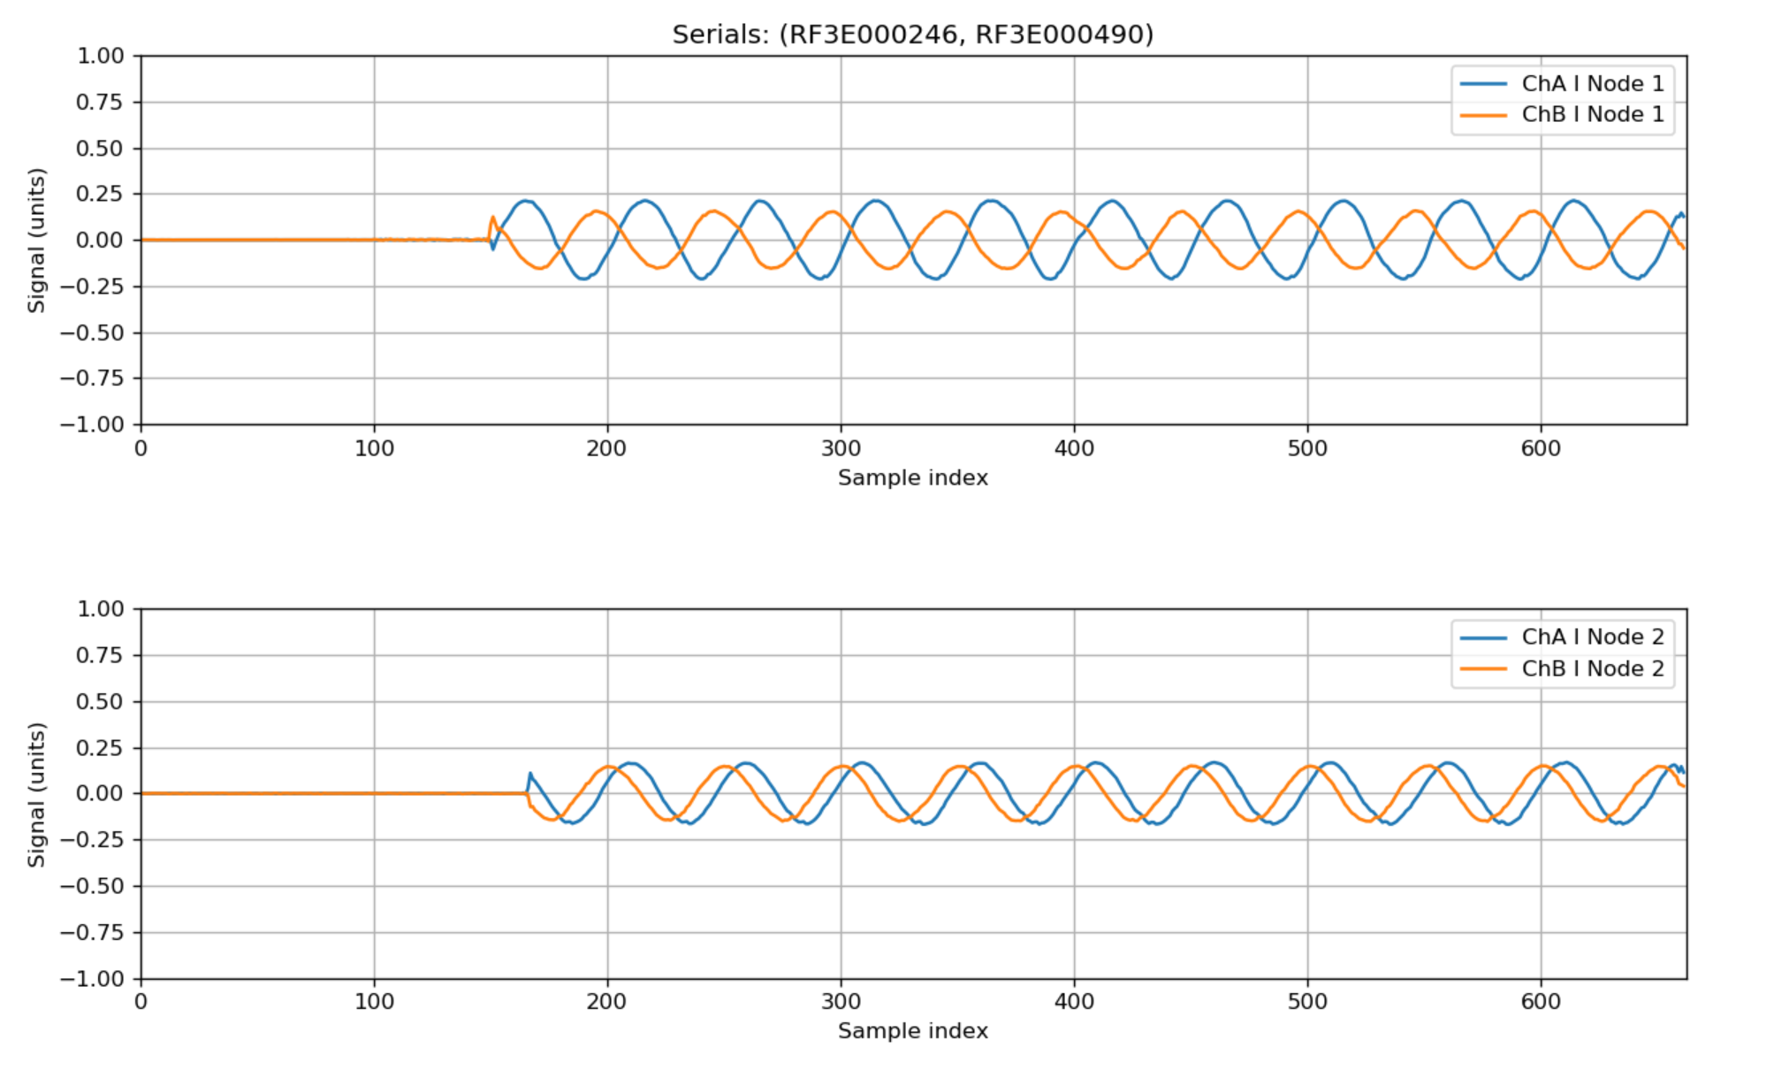
TDD Framer: Real-Time Visualizations

Slide 16
mMIMO Beacon Beam-sweeping

Slide 17
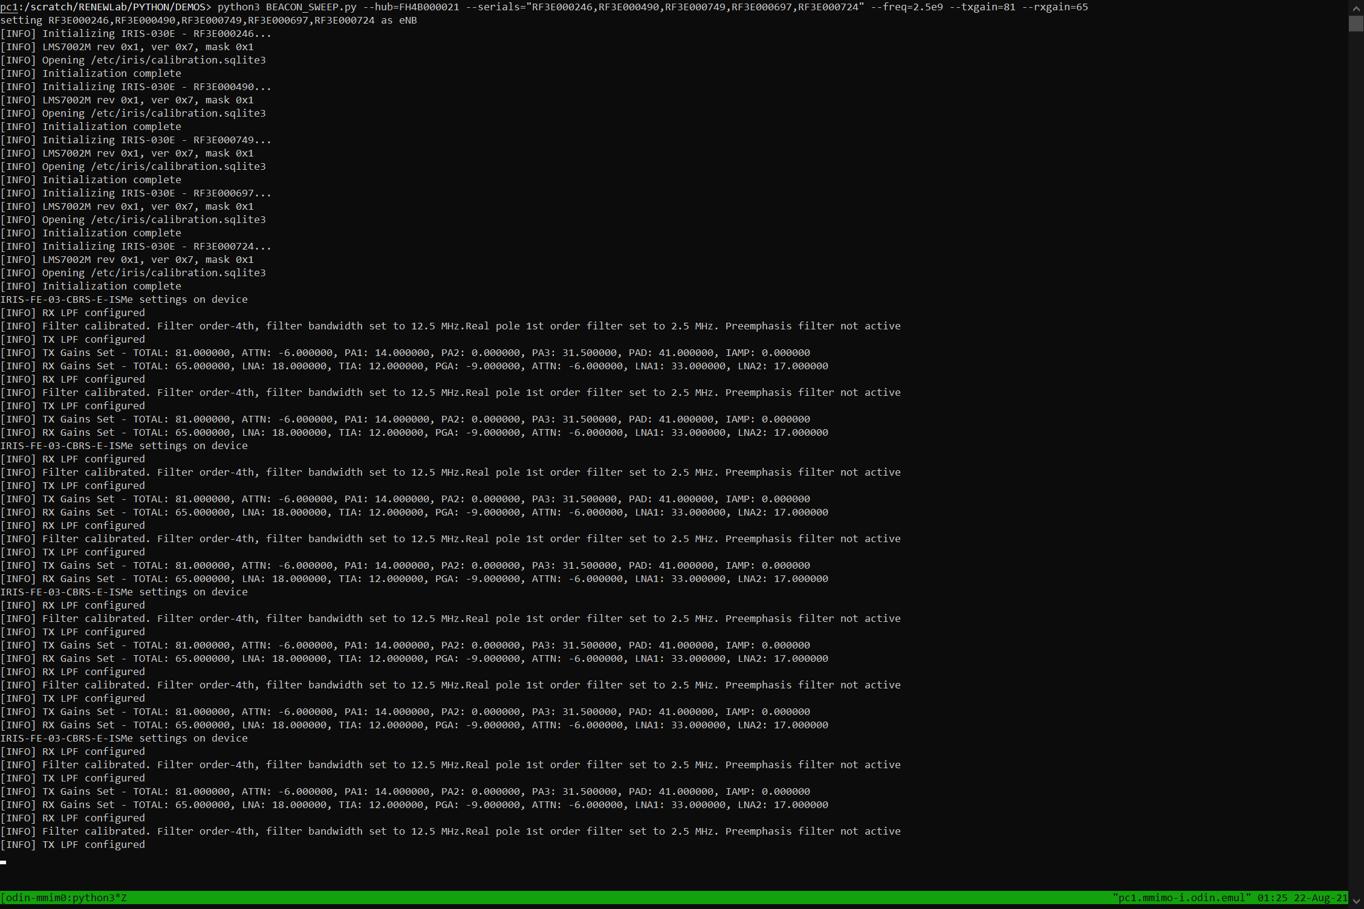
mMIMO Beacon Beam-sweeping: BS Operation (1)
Frequency = 2.5 GHz | Tx gains = 81 dB | Rx gains = 65 dB
Using Channel A on 5 SDRs at the mMIMO BS for this experiment
Configuring the BS SDRs that were explicitly provisioned in the script call

Slide 18
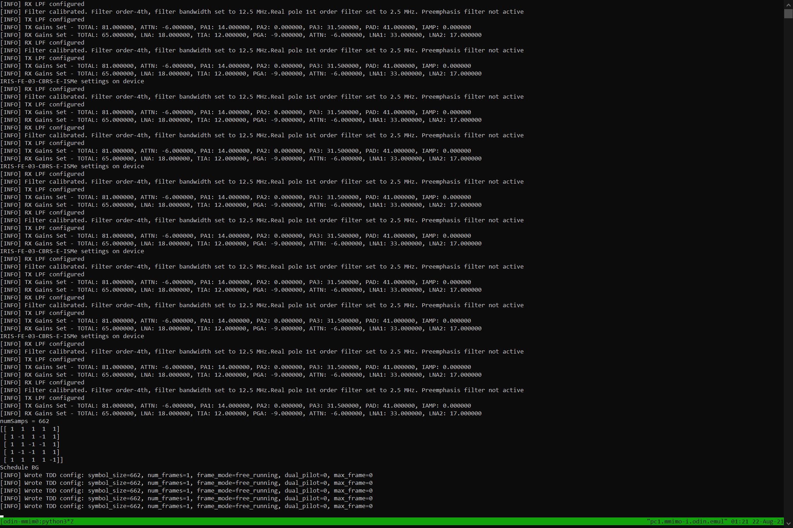
mMIMO Beacon Beam-sweeping: BS Operation (2)
The 5x5 Hadamard beacon weight matrix
Write TDD configuration (‘BG’) to an SDR & BEACON_START

Slide 19
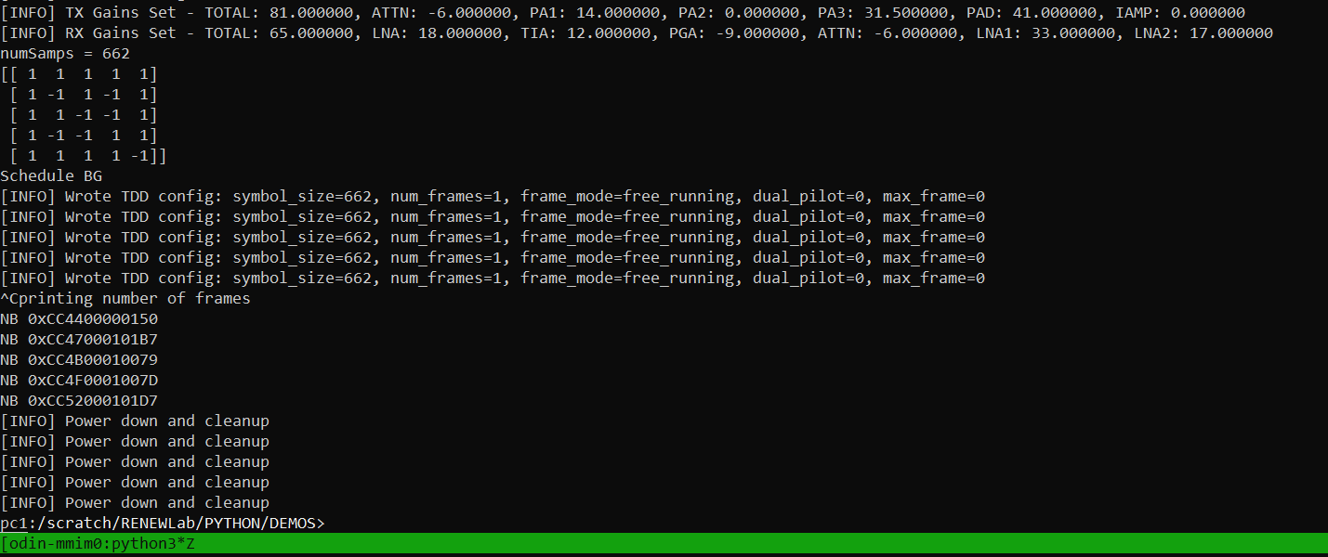
mMIMO Beacon Beam-sweeping: BS Operation (3)
Manual termination of the script’s operation [expected behavior]
Power-down and Cleanup of all 5 provisioned SDRs

Slide 20
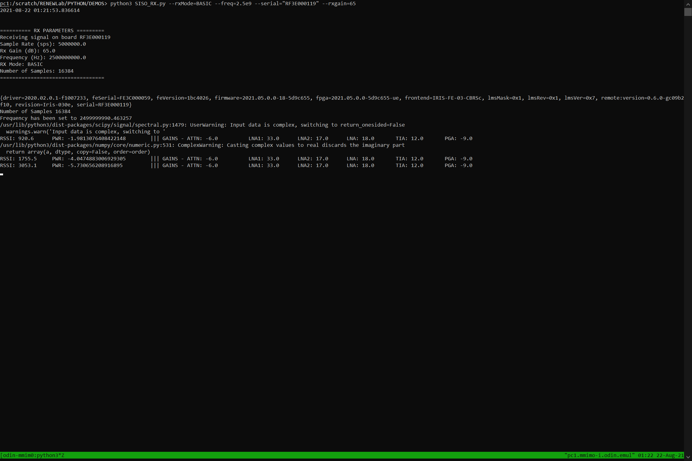
mMIMO Beacon Beam-sweeping: Simultaneous Client Operation
Client configuration
A single standalone client is provisioned for the reception of these beacons from 5 BS-based SDR antennas (Channel-A)
Received beacon RSSI logging for an association heuristic
(E.g., Associate the client with the BS SDR whose signal has the highest RSSI value)

Slide 21
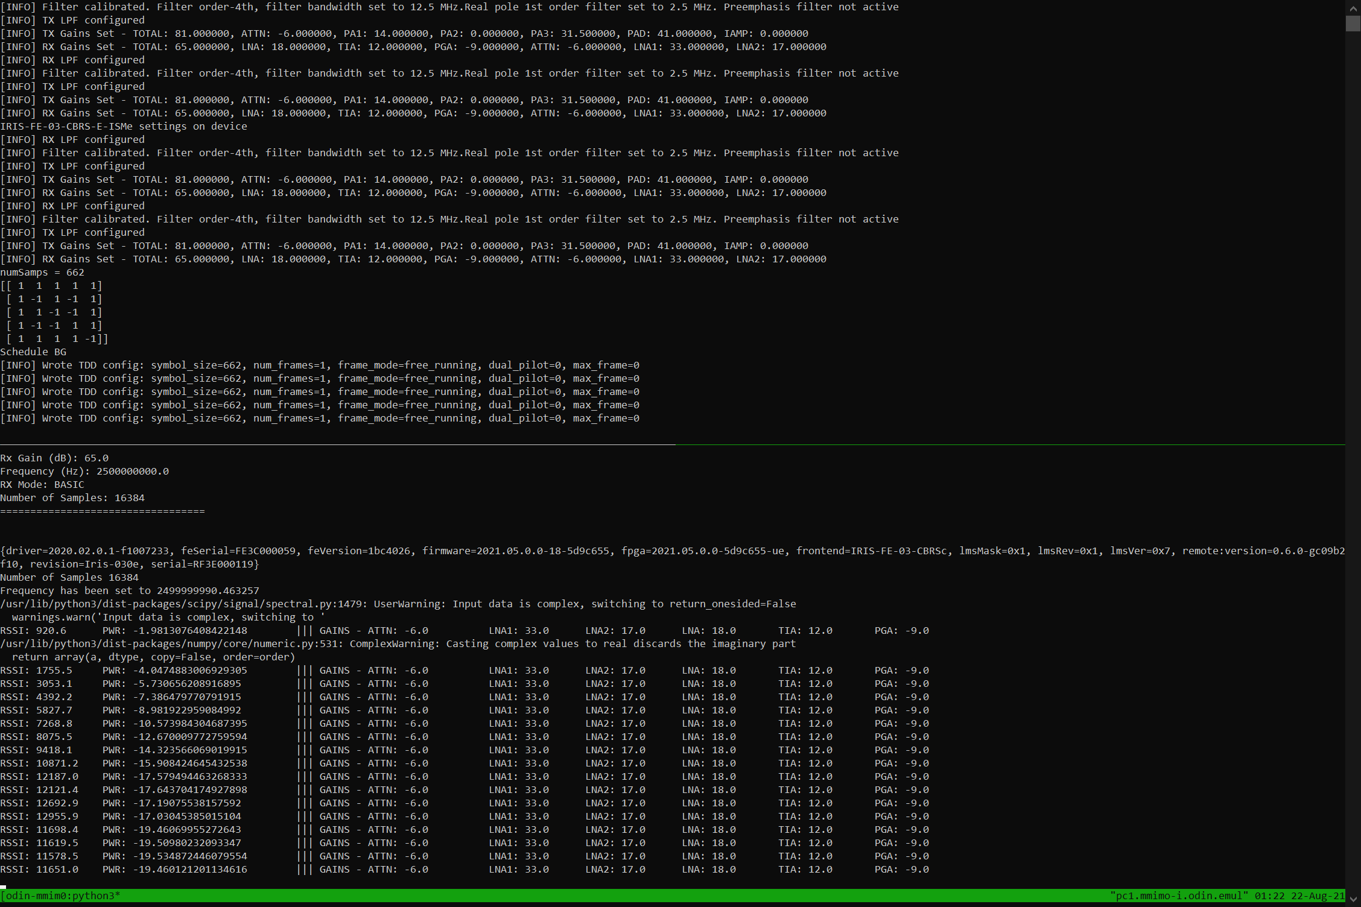
mMIMO Beacon Beam-sweeping: Complete Console View

Slide 22
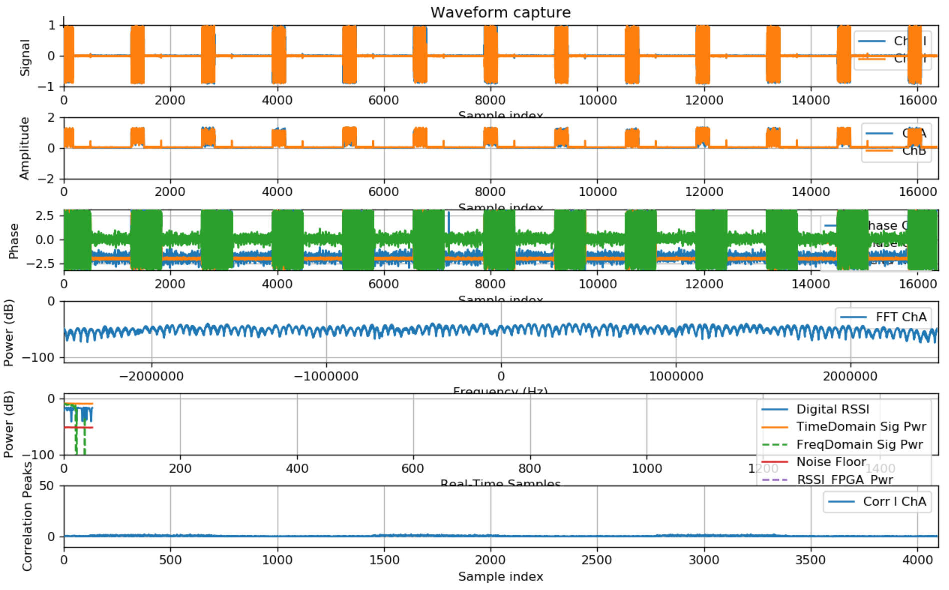
mMIMO Beacon Beam-sweeping: Real-Time Visualizations

Slide 23
A Full-scale Massive MIMO Experiment: Sounder
A sounder framework – with & without uplink data
Use the concepts detailed earlier (SISO Tx/Rx, TDD Framer, Beam-sweep)
48 BS antennas | 4 client antennas | Uplink data generation | HDF5 analyses
The BS, the Aggregation Hub, and both clients are inside an anechoic chamber
Record pilot signals from the 2 Iris clients received at all the antennas of the Skylark/Faros mMIMO BS ((6 RHs x 4 SDRs) x 2 Tx/Rx chains = 48 antennas)
Post-process these recorded signals (HDF5 matrices) for channel statistics
Visualize using Python scripts and MATLAB tool-boxes

Slide 24
mMIMO Sounder
(with & without uplink data)

Slide 25
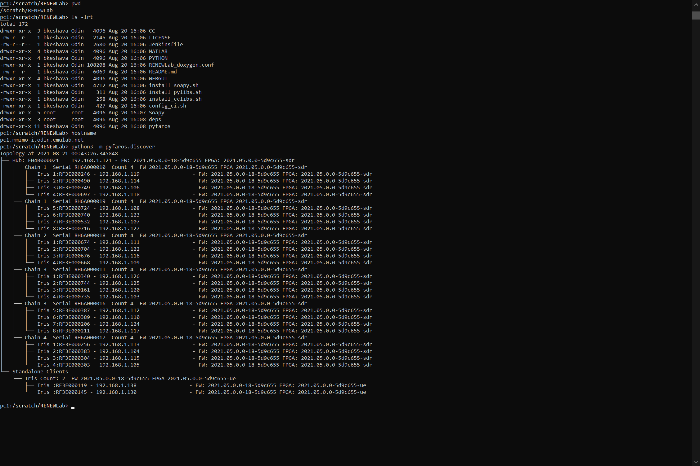
mMIMO Sounder: Radio Discovery
6 RHs x 4 SDRs per RH = 24 SDRs x 2 Tx/Rx chains = 48 antennas at the mMIMO BS
2 standalone Iris SDRs as the clients

Slide 26
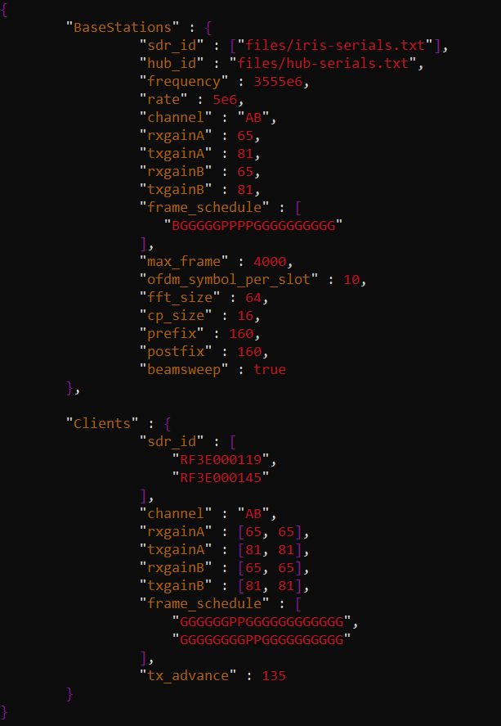
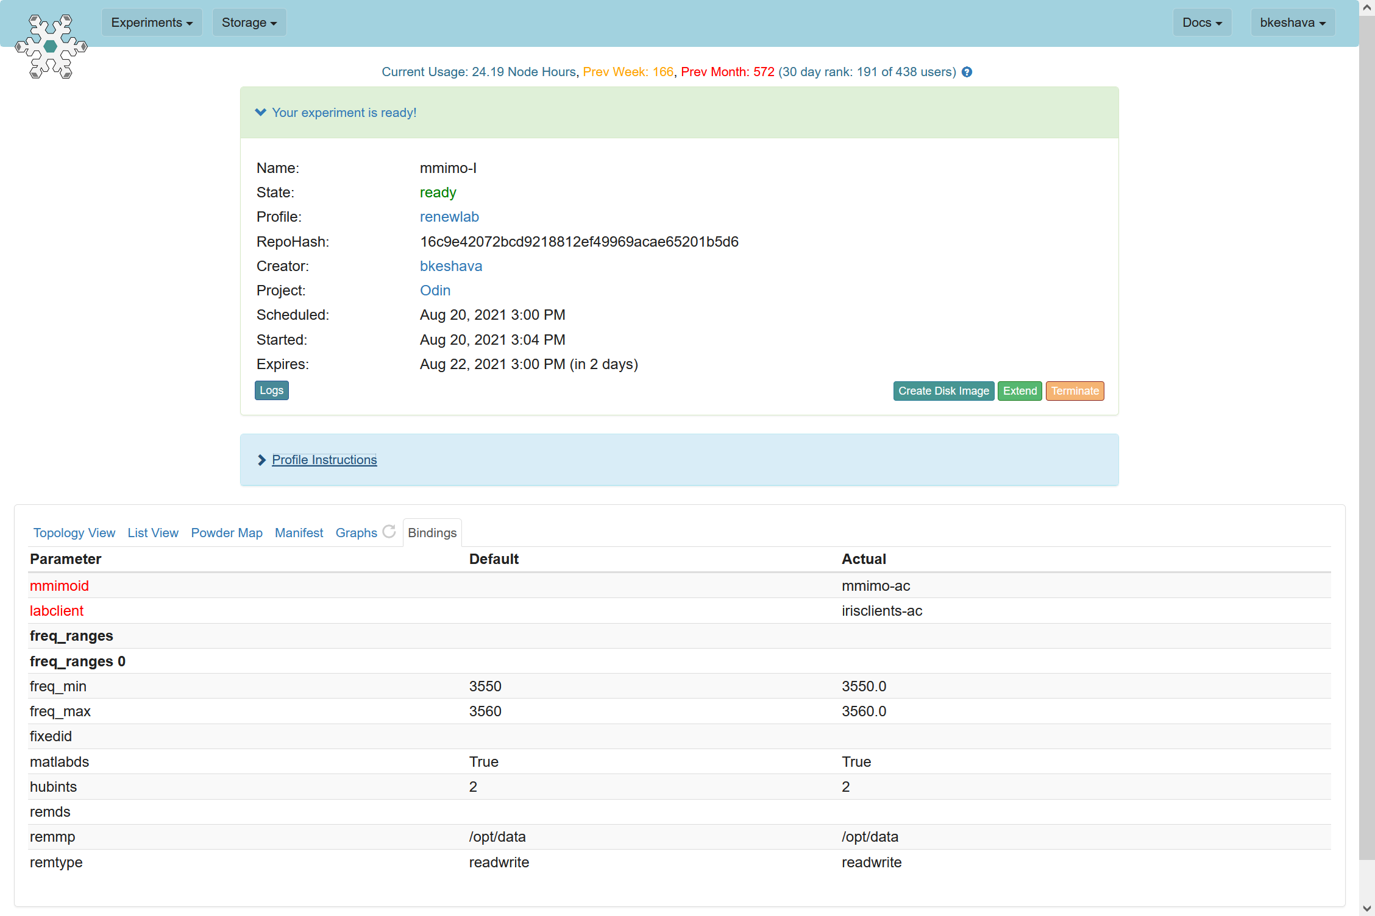
mMIMO Sounder: JSON Configuration File
Experiment Binding: Reserved Frequency Range
Client SDR IDs
BS Daisy-Chained & Aggregated Iris SDR IDs: RF3E000246, RF3E000490, RF3E000749, RF3E000697, RF3E000724, RF3E000740, RF3E000532, RF3E000716, RF3E000674, RF3E000704, RF3E000676, RF3E000668, RF3E000340, RF3E000744, RF3E000161, RF3E000735, RF3E000387, RF3E000389, RF3E000206, RF3E000211, RF3E000256, RF3E000383, RF3E000304, RF3E000303.
Faros Aggregation Hub ID: FH4B000021
conf-bs-and-two-client.json

Slide 27
mMIMO Sounder: Configuration Parameters
2 Tx/Rx channels per Iris SDR at the Base Station | 48 antennas in total at the Base Station
Center Frequency = 3555 MHz | Sample Rate = 5 Msps
Max Tx Gain at the Base Station = 81 dB | Max Tx Gain at a Client = 98 dB
Frame Schedule Details:
Guard Interval (‘G’)
Broadcast Beacon from the Base Station to the Clients (‘B’)
Pilot from a Client to the Base Station (‘P’)
FFT Size for Pilot OFDM symbols = 64
Cyclic Prefix Length = 16
802.11 LTS-type pilot used for [fft_size = 64]
Number of OFDM symbols per slot = 10
OFDM symbol size = fft_size + cp_len = 80 samples
52 Non-Zero OFDM Sub-Carriers used in each OFDM symbol [fft_size = 64]

Slide 28
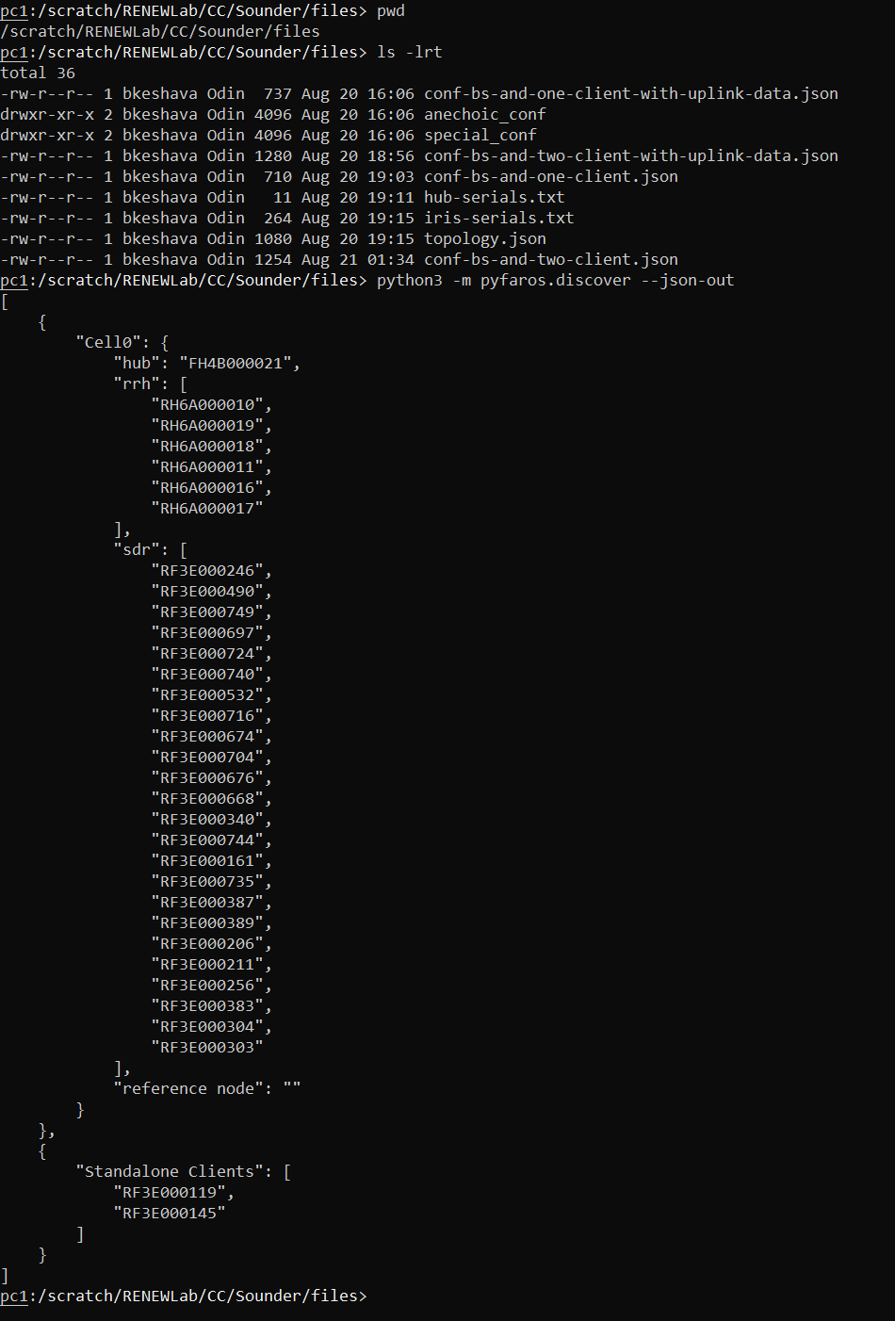
mMIMO Sounder: Topology Confirmation
One mMIMO Base Station: Designated Cell0
A Reference Node can be used at the BS for reciprocity calibration: not used here
Make sure the serial numbers (IDs) of the Hub, the Base Station RHs and their constituent SDRs – along with the standalone clients are correct

Slide 29
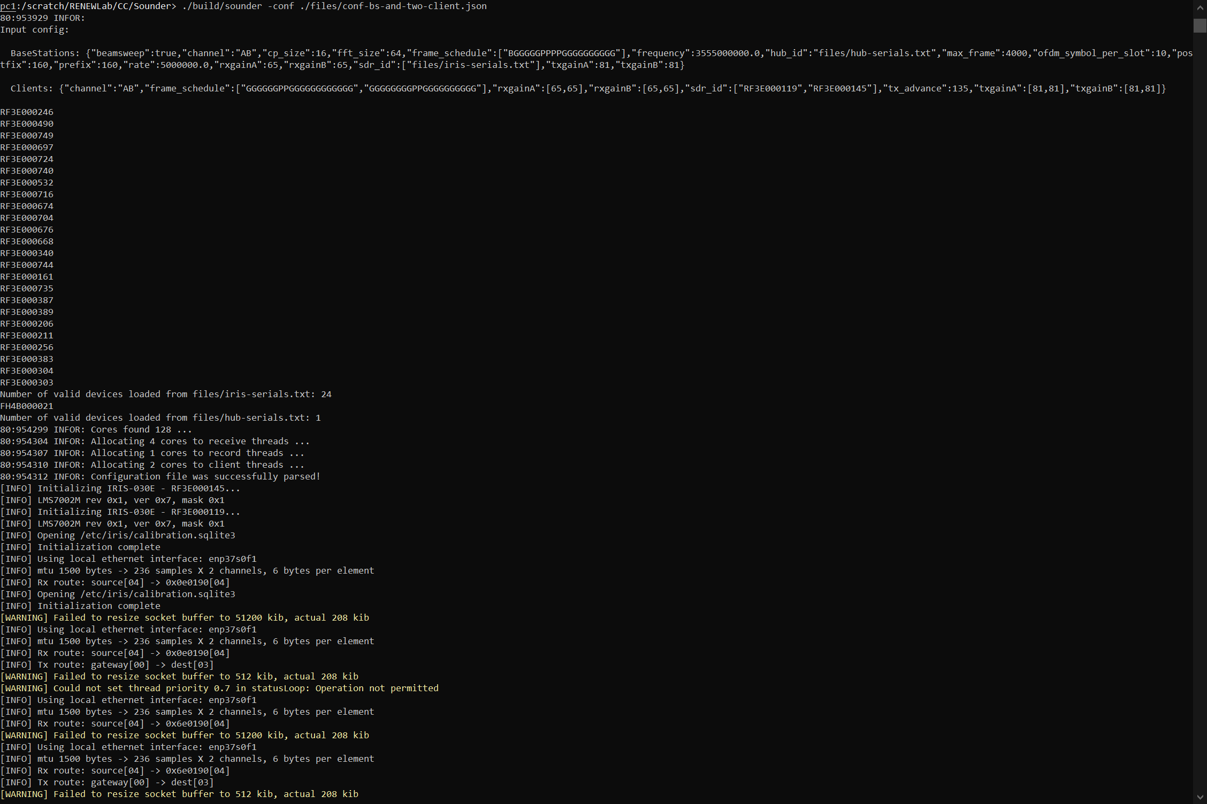
mMIMO Sounder: Start-up
Start the Sounder Application
Load the provided configuration: conf-bs-and-two-client.json
mMIMO BS Device Identification: 24 Iris SDRs | One Faros Aggregation Hub
Initializing the Standalone Iris Clients

Slide 30
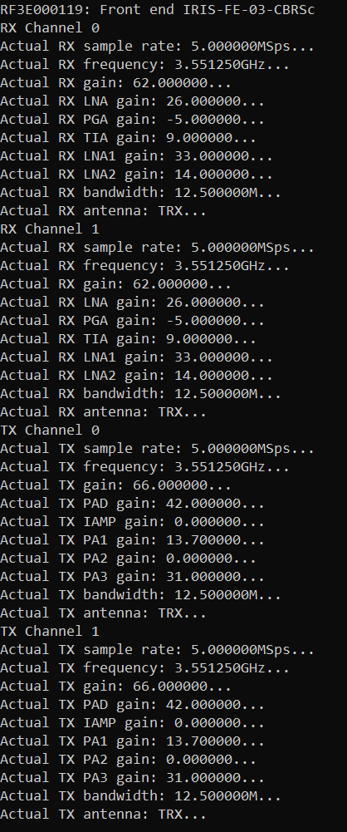
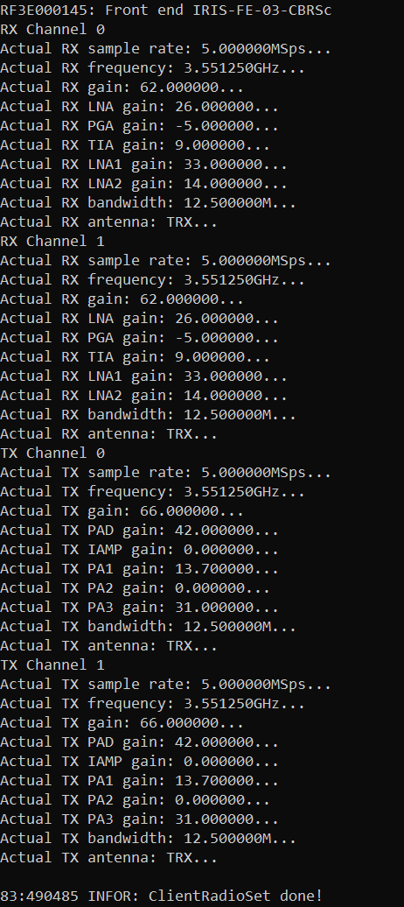
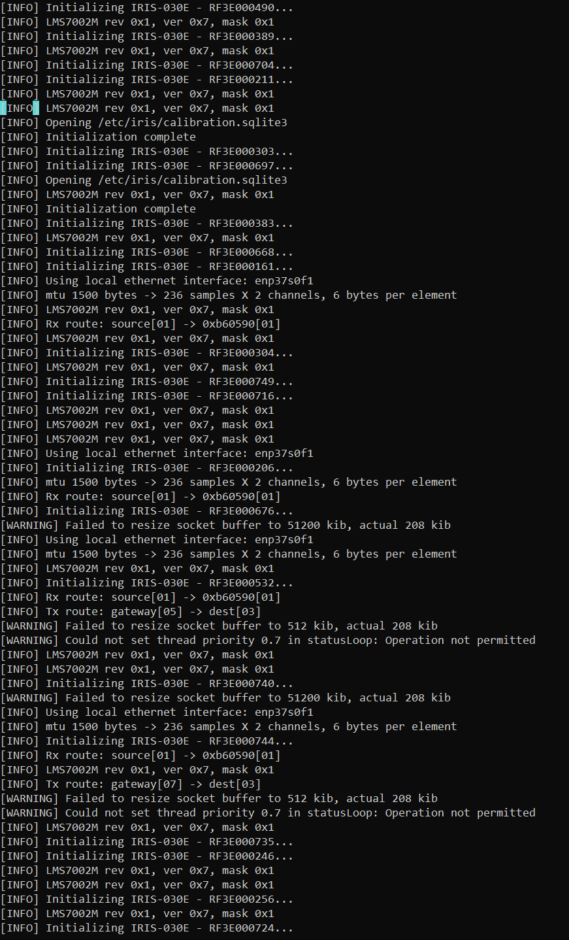
mMIMO Sounder: Setting up the Radios (1)
Standalone Iris Client-2 Setup
mMIMO BS SDRs Initialization
Standalone Iris Client-1 Setup

Slide 31
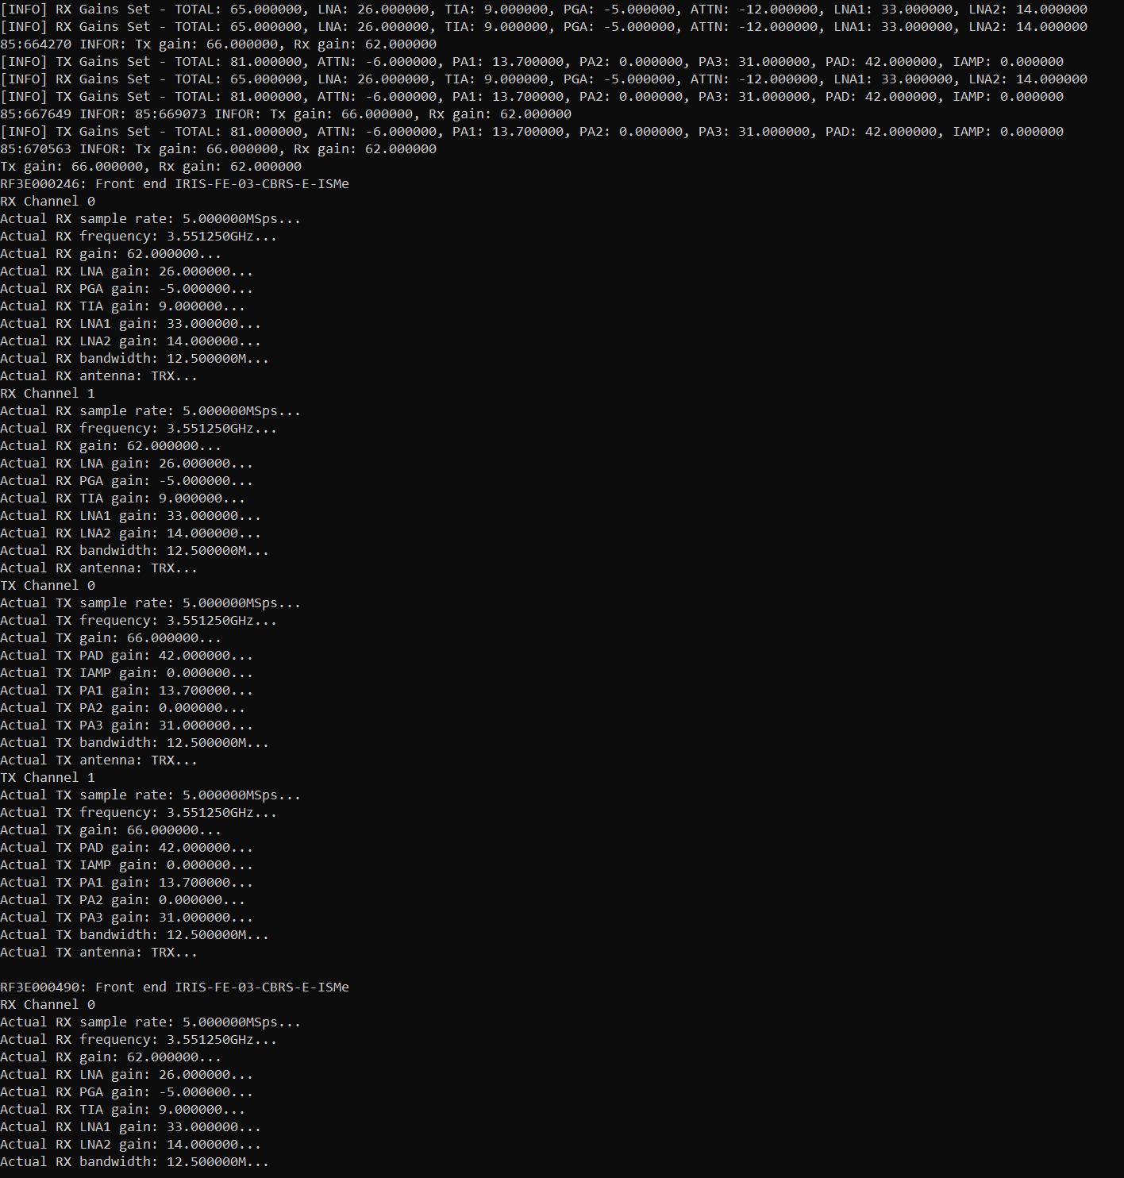
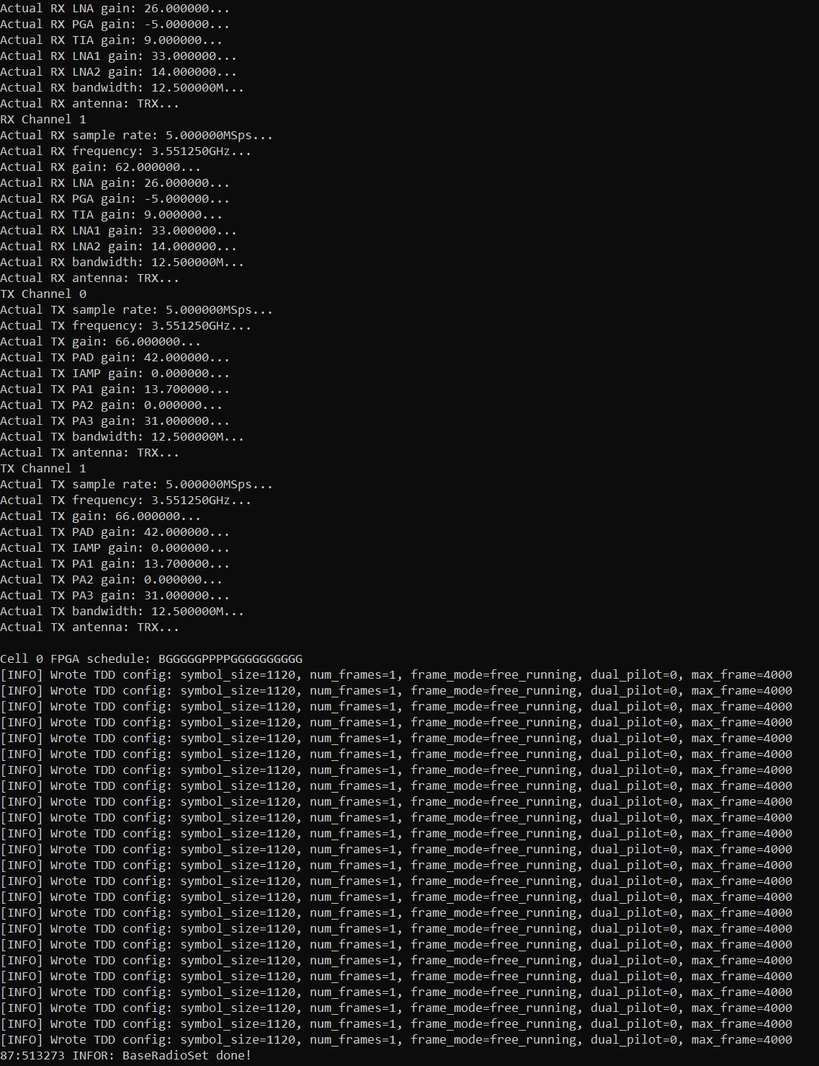
mMIMO Sounder: Setting up the Radios (2)
mMIMO BS SDRs Frame Schedule:
Beacon beam-sweep in the 1st frame;
Pilots from 4 client antennas;
Guard intervals in-between;
No uplink data
Writing TDD config to all 24 SDRs at the mMIMO BS
mMIMO BS SDRs Setup

Slide 32
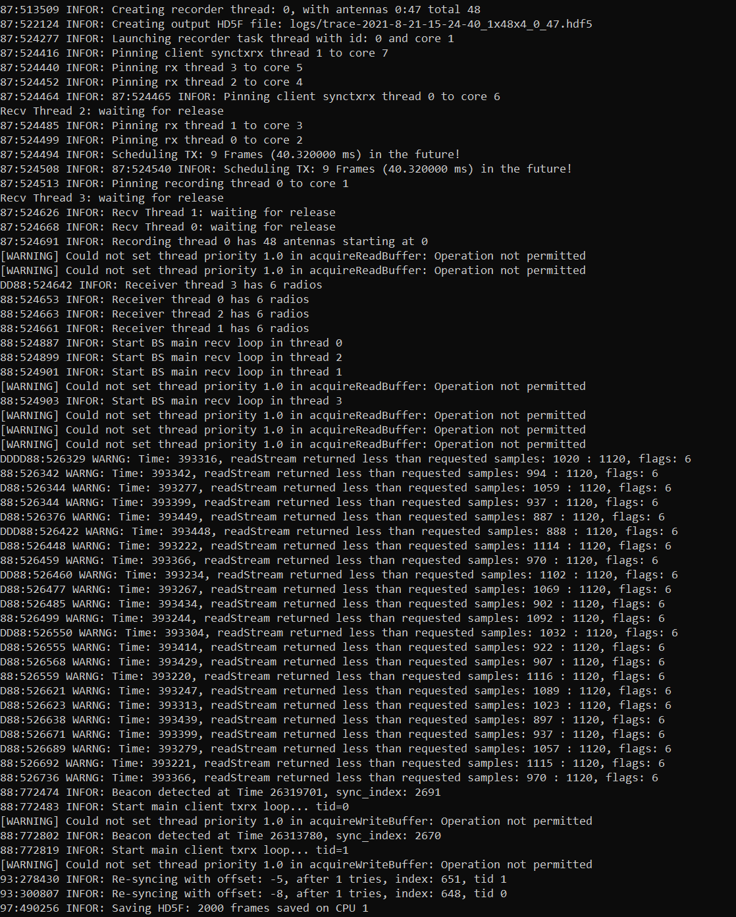
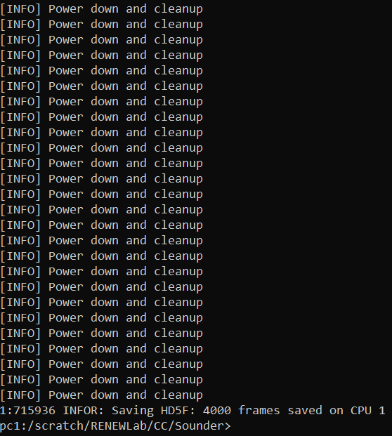
mMIMO Sounder: Operation & Cleanup
4 recv threads: 6 BS SDRs per thread
Client-1: Beacon detected | Send pilots
mMIMO BS SDRs Power-down and Cleanup
Client-2: Beacon detected | Send pilots
Saving HDF5 logs

Slide 33
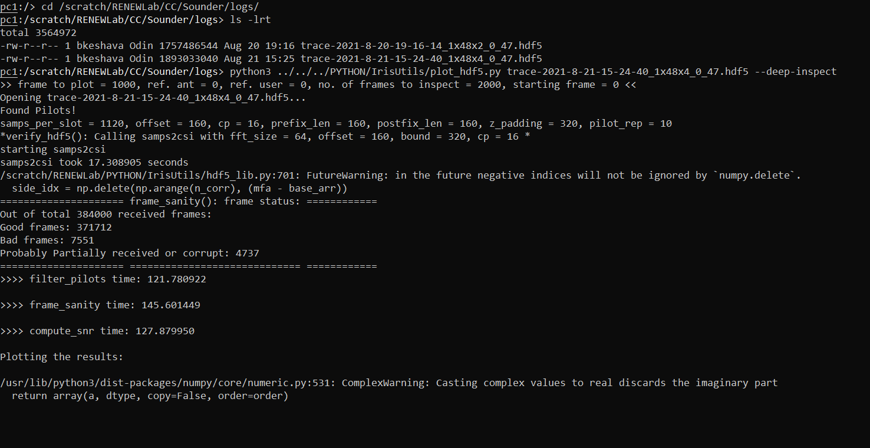
mMIMO Sounder: Visualizations (1)
Our analysis using 1 standalone Iris client (2 Tx/Rx channels)
Log file of our current analysis (2 clients – 4 Tx/Rx channels)

Slide 34
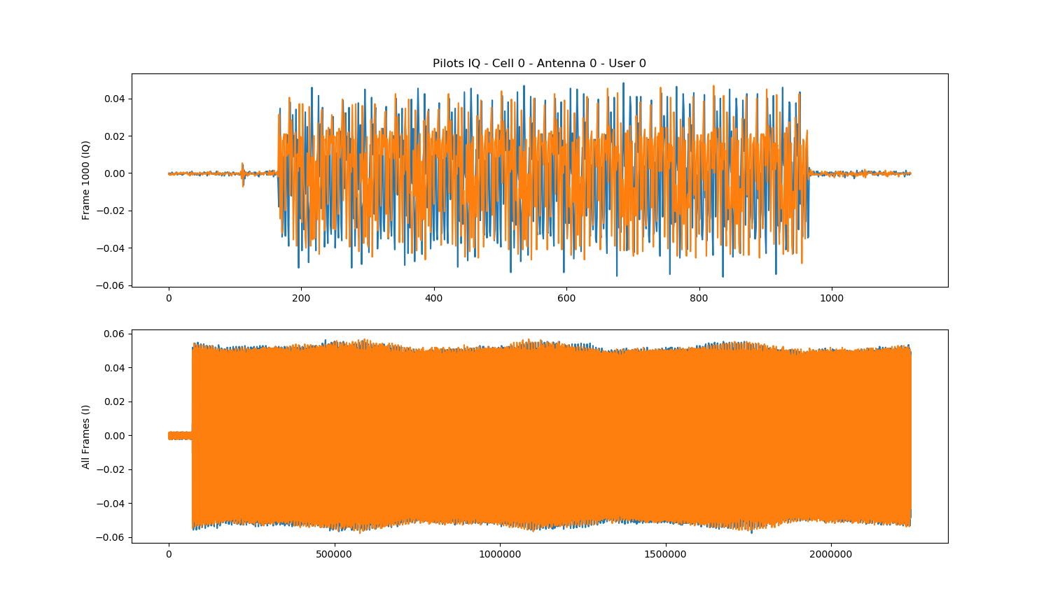
mMIMO Sounder: Visualizations (2)

Slide 35
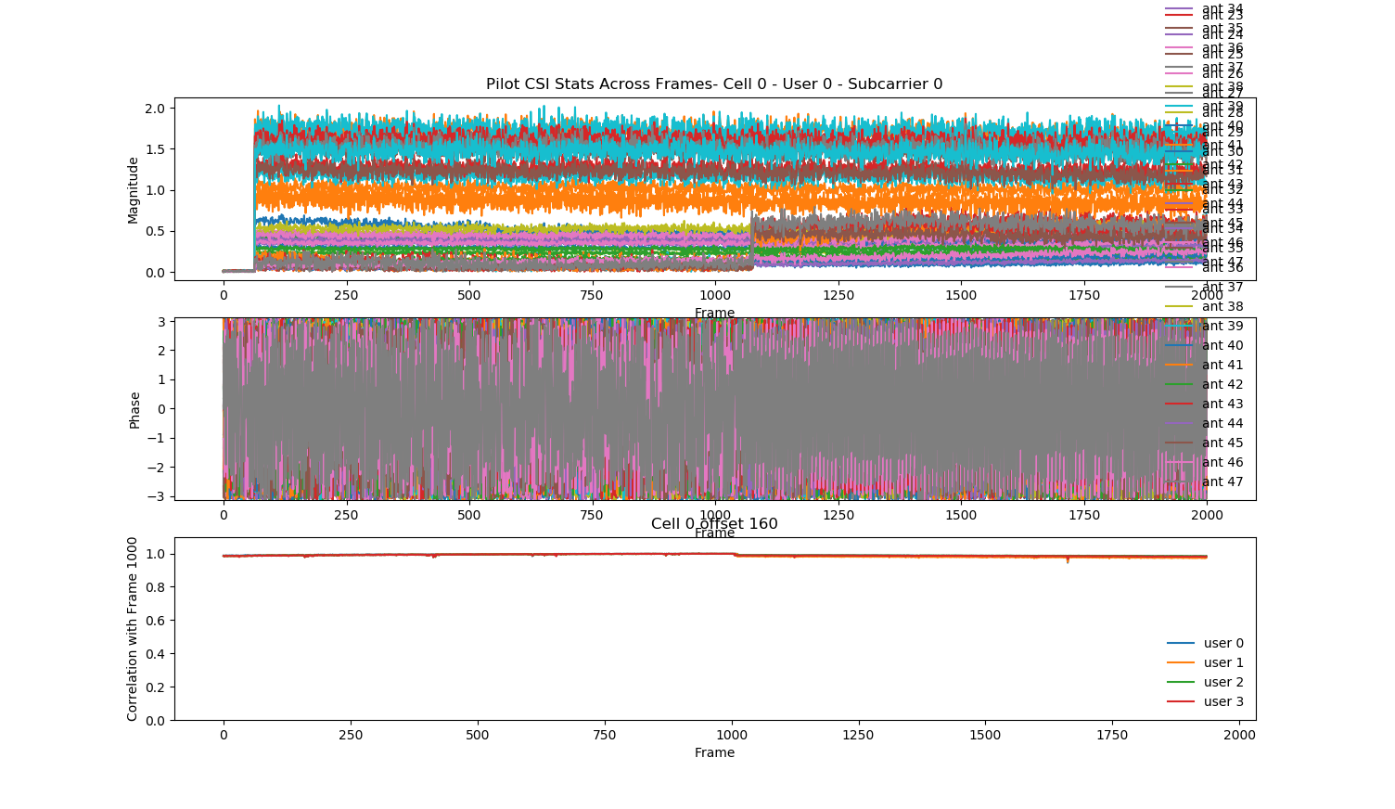
mMIMO Sounder: Visualizations (3)

Slide 36
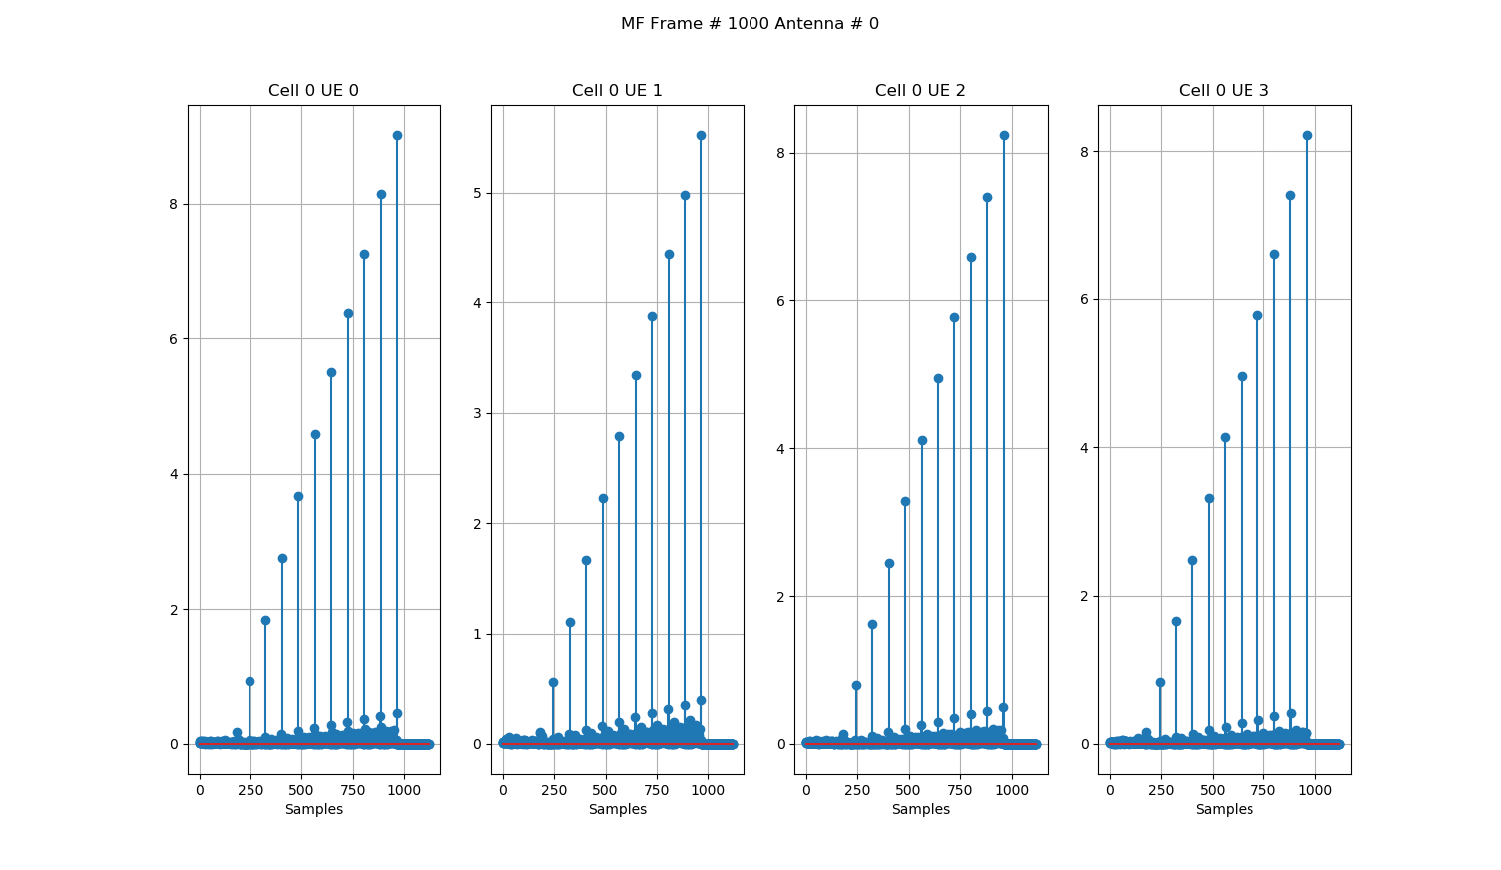
mMIMO Sounder: Visualizations (4)

Slide 37
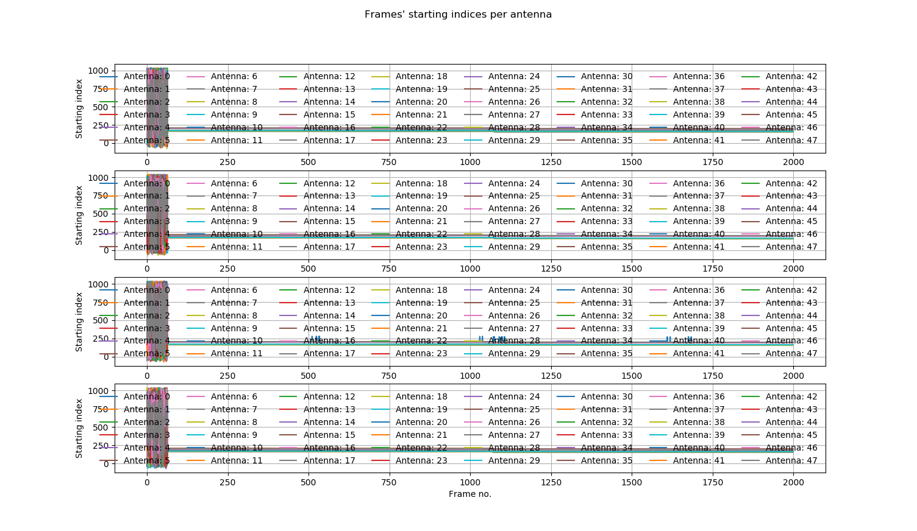
mMIMO Sounder: Visualizations (5)

Slide 38
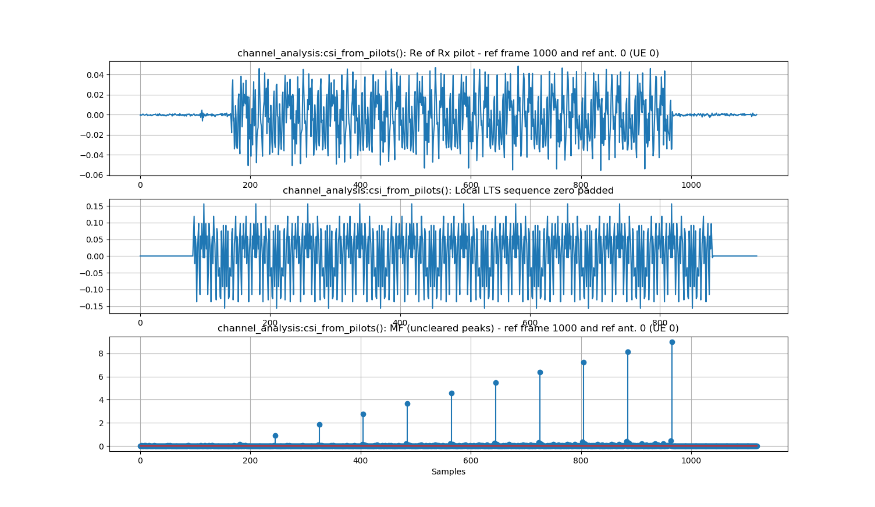
mMIMO Sounder: Visualizations (6)

Slide 39
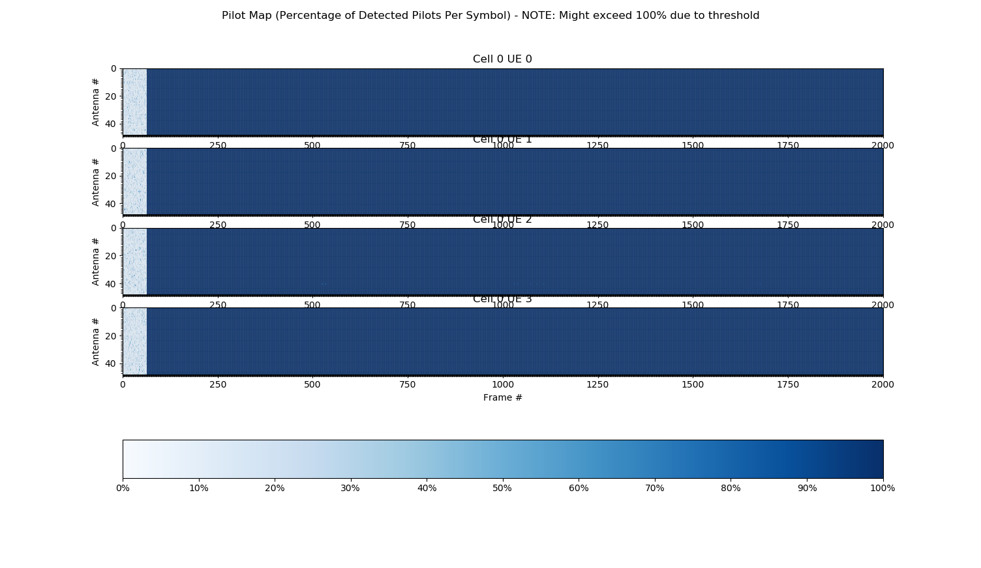
mMIMO Sounder: Visualizations (7)

Slide 40
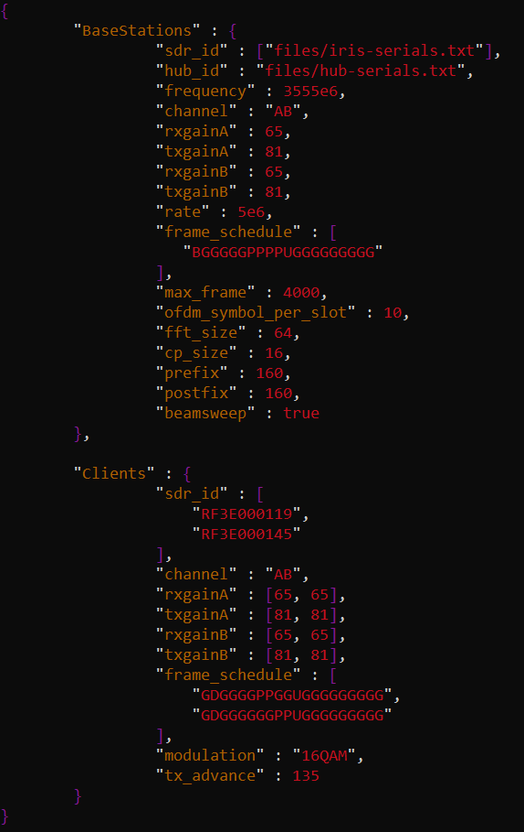
mMIMO Sounder with Uplink Data: Configuration
Frame schedule updated to include uplink frames from both standalone Iris clients
Other configurations remain the same
Modulation scheme (QAM16) for the uplink data

Slide 41
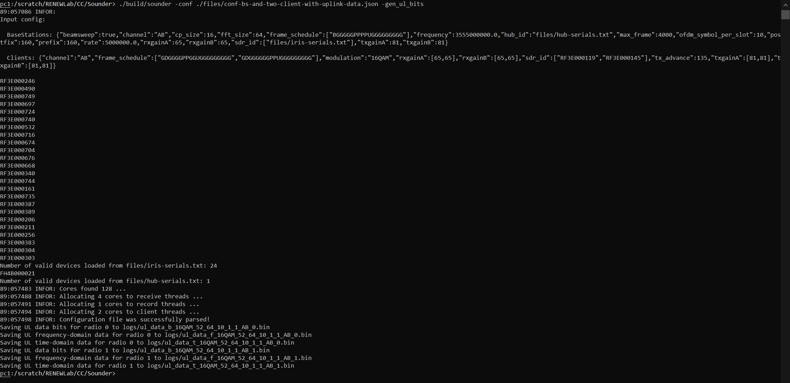
mMIMO Sounder with Uplink Data: Generation (1)

Slide 42
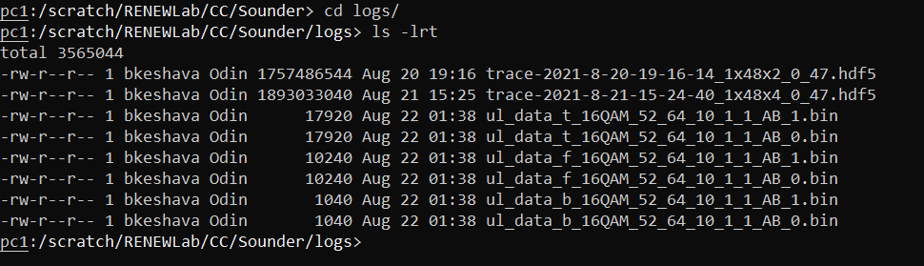
mMIMO Sounder with Uplink Data: Generation (2)
*Operational behavior remains the same as with the previous case (without uplink data)

Slide 43
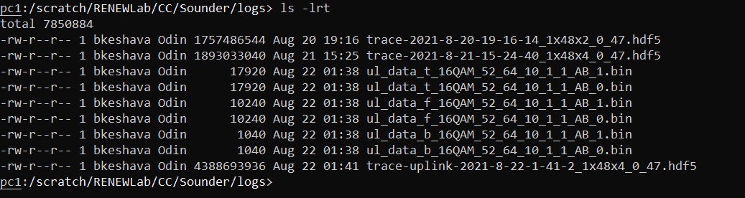
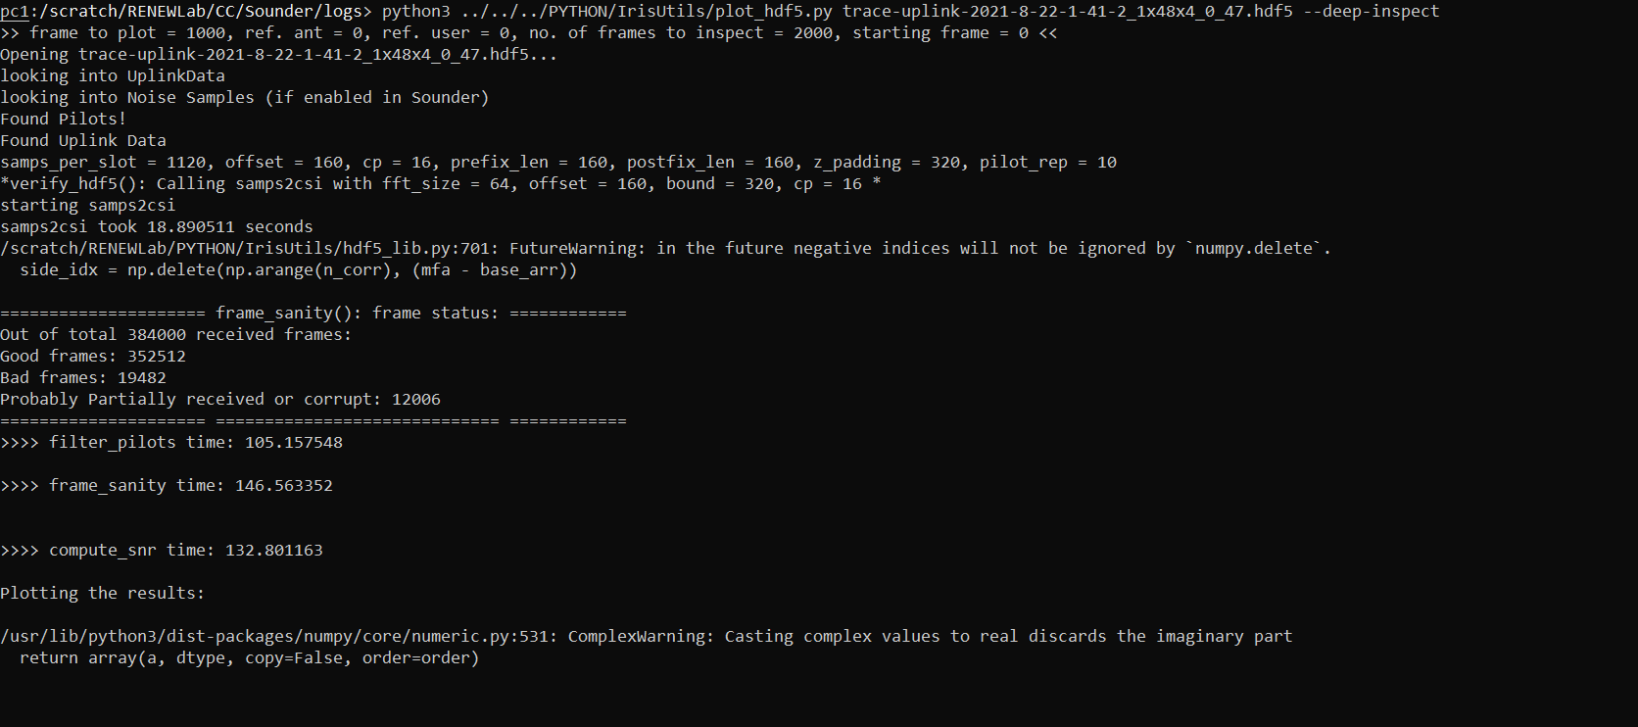


mMIMO Sounder with Uplink Data: Visualizations (1)
Log file for our current analysis
(48 BS antennas | 4 client antennas | With uplink data

Slide 44
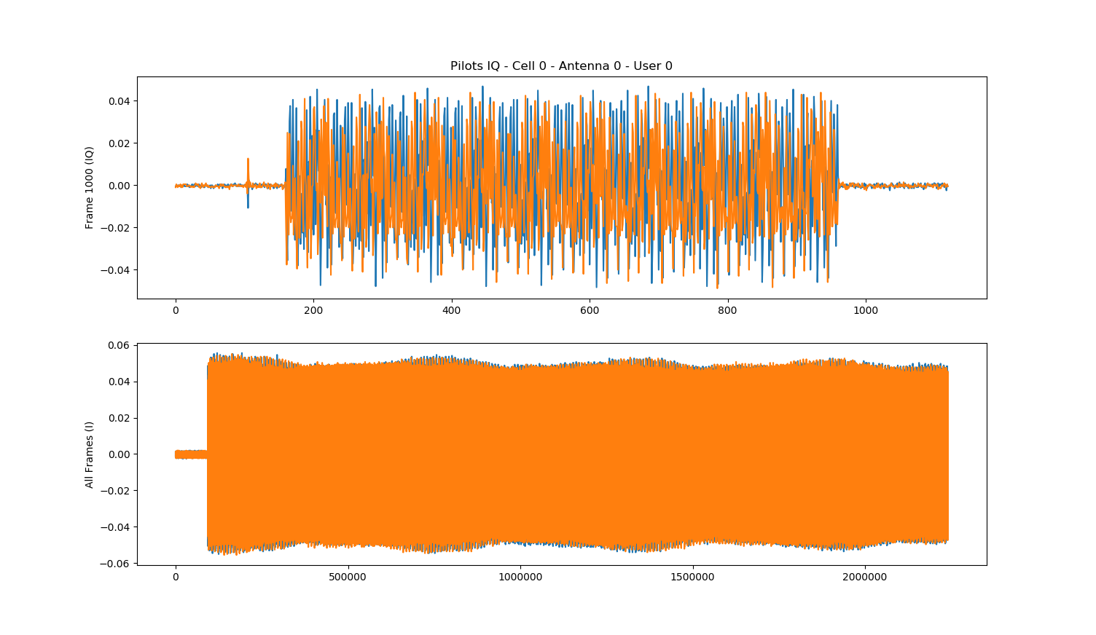
mMIMO Sounder with Uplink Data: Visualizations (2)

Slide 45
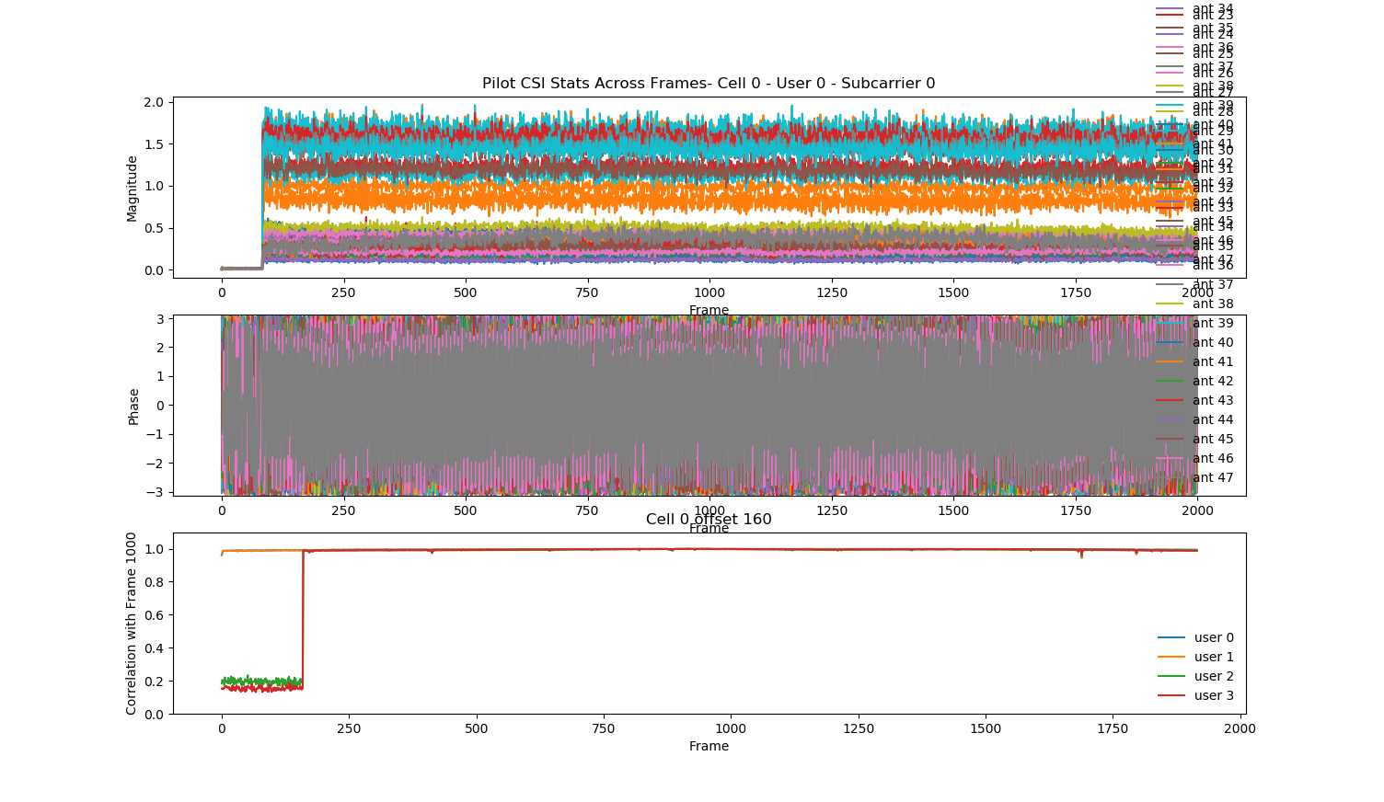
mMIMO Sounder with Uplink Data: Visualizations (3)

Slide 46
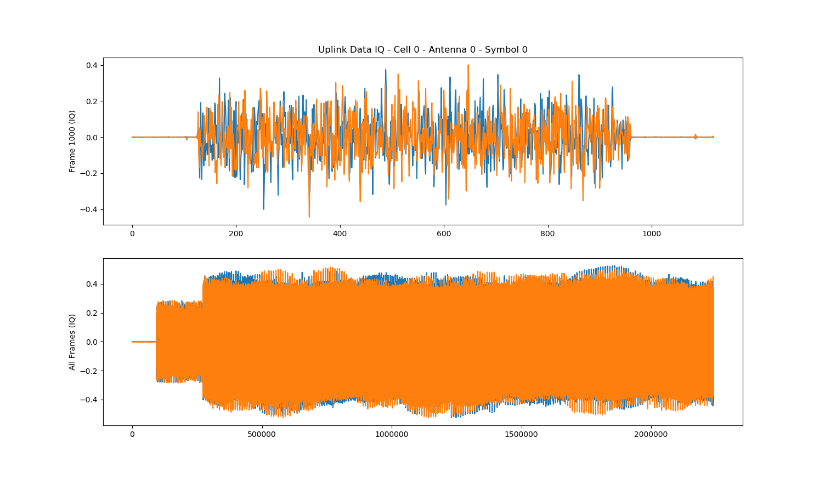
mMIMO Sounder with Uplink Data: Visualizations (4)

Slide 47
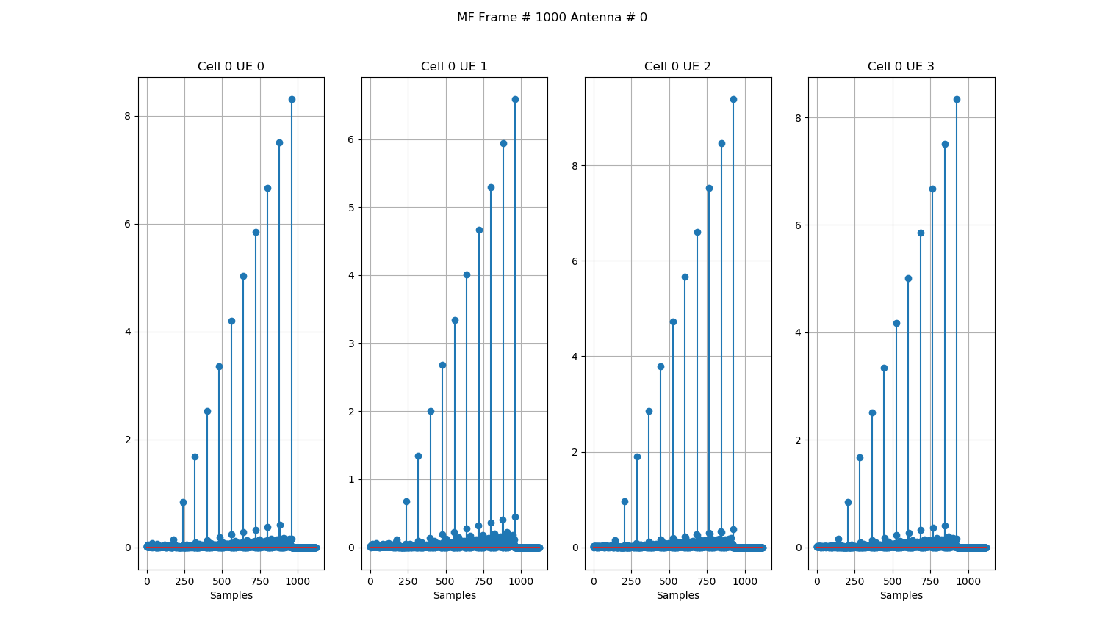
mMIMO Sounder with Uplink Data: Visualizations (5)

Slide 48
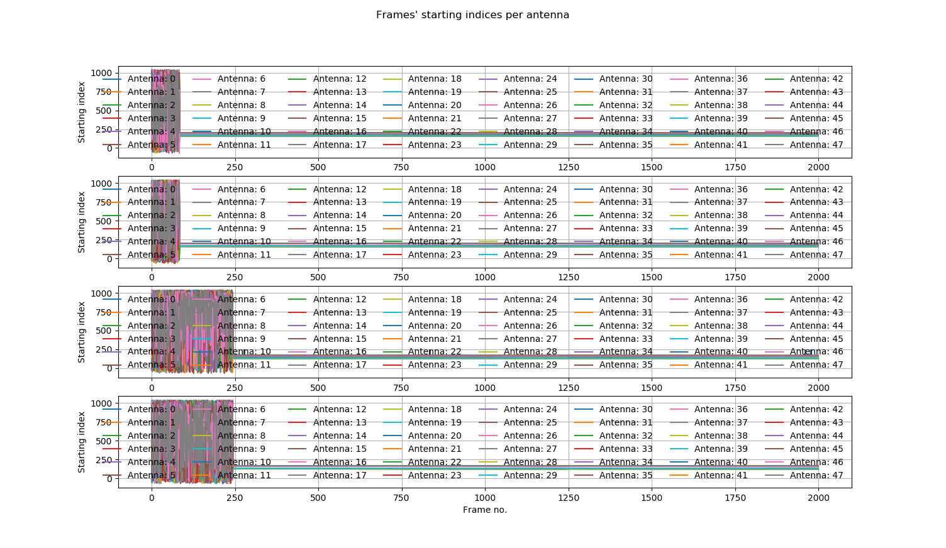
mMIMO Sounder with Uplink Data: Visualizations (6)

Slide 49
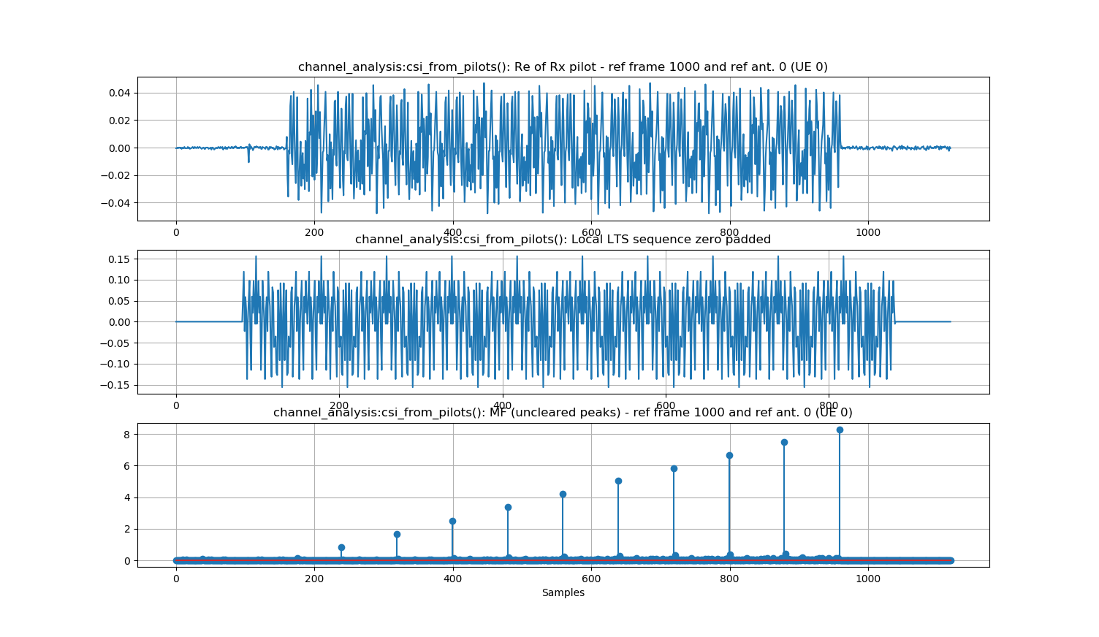
mMIMO Sounder with Uplink Data: Visualizations (7)

Slide 50
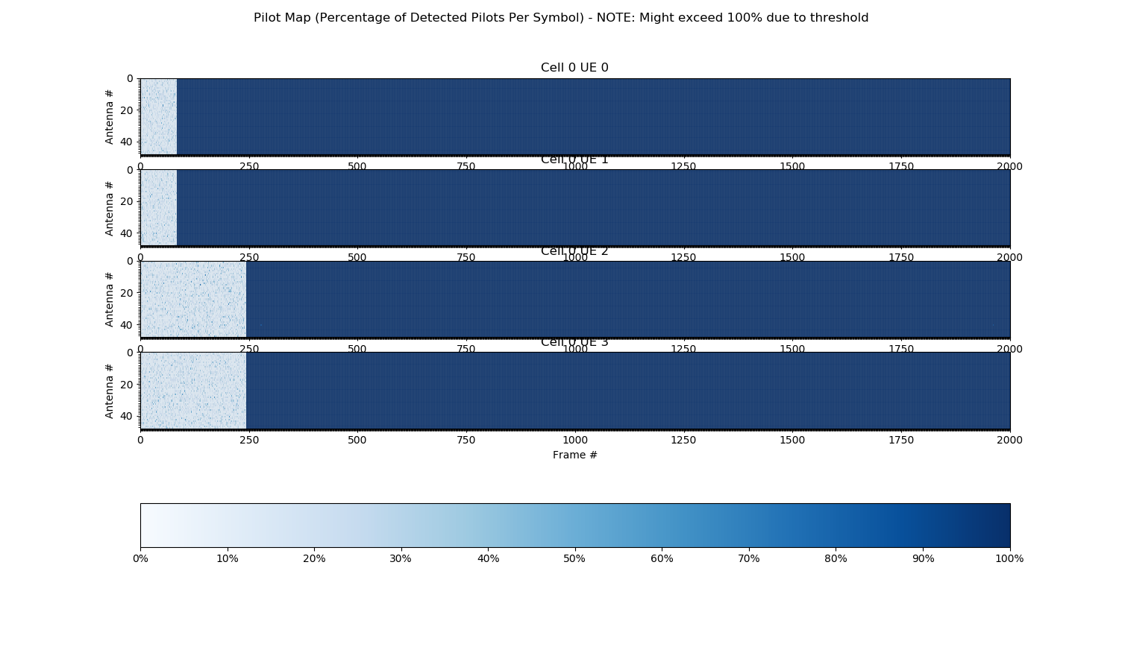
mMIMO Sounder with Uplink Data: Visualizations (8)

Slide 51
Next Steps & Questions
What other experiments would we like to have done on this anechoic chamber based mMIMO testbed at POWDER?
MATLAB toolbox based designs (see previous slide),
Beam-Forming (Zero-Forcing/Conjugate),
Channel Condition Number Evaluations, etc.
Are we ready to start experimenting with pi-radio: the 4x4 MIMO SDR from NYU capable of operating in the 57 – 64 GHz band?
Example paper to analyze: M. Polese, F. Restuccia, and T. Melodia, “DeepBeam: Deep Waveform Learning for Coordination-Free Beam Management in mmWave Networks,” arXiv:2012.14350, doi: 10.1145/3466772.3467035

Slide 52
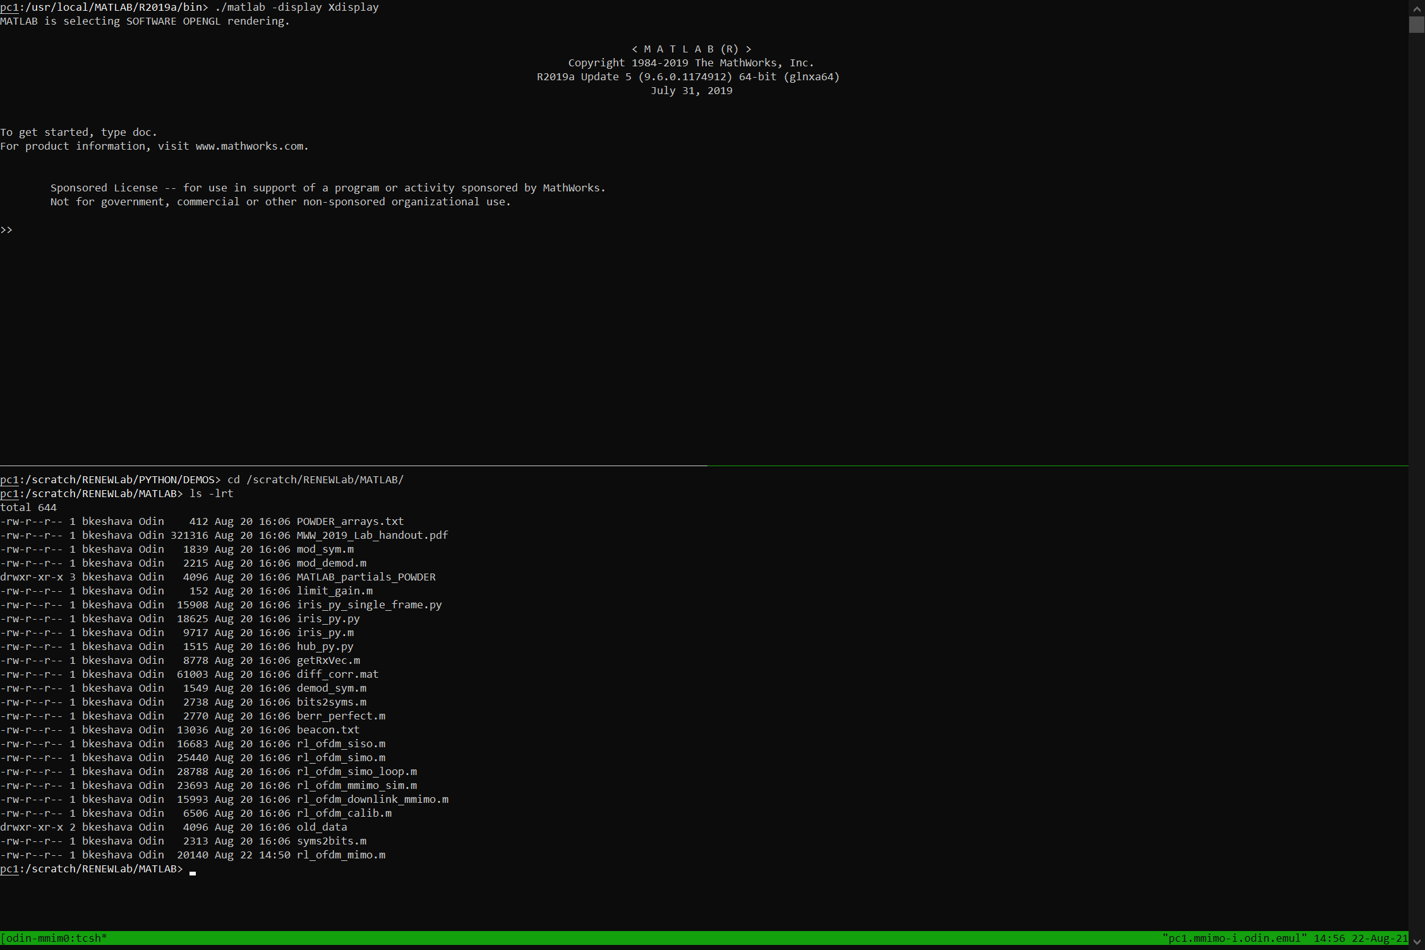
RENEW/POWDER mMIMO: MATLAB Demos

Slide 53
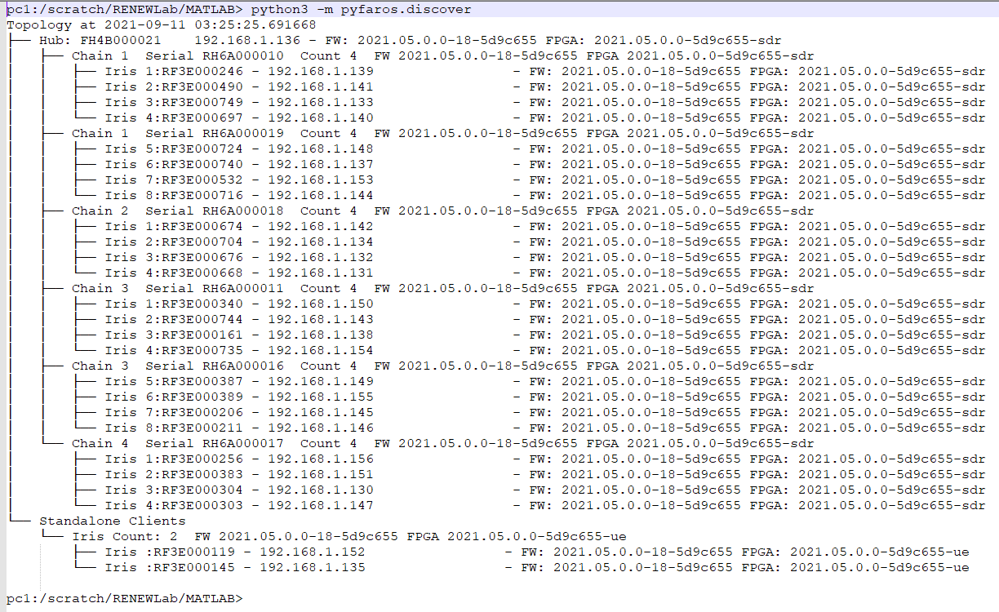
MATLAB OFDM Sounder: Configuration
Number of BS Nodes = 8
Number of Clients (UEs) = 2
Tx/Rx Frequency = 3555 MHz
Tx Gain = 42 dB
Rx Gain = 20 dB
Sample Rate = 5 Msps
Number of OFDM Symbols = 44
Modulation Order = QAM16
Number of Sub-Carriers = 64
Cyclic Prefix Length = 16

Slide 54

mMIMO MATLAB Demo: OFDM Sounder

Slide 55

mMIMO OFDM Sounder: Tx Signal at the 2 UEs

Slide 56

mMIMO OFDM Sounder: Rx Signal at the 8 BS nodes

Slide 57

mMIMO OFDM Sounder: LTS Correlation at the 8 BS nodes

Slide 58

mMIMO OFDM Sounder: Constellation Maps

Slide 59

mMIMO OFDM Sounder: Channel Estimation

Slide 60

mMIMO OFDM Sounder: EVM and SINR

Slide 61
Please refer to the accompanying console logs for more details on the demodulated Rx data, beam-forming weights, SNRs (x2 UEs), and symbol/bit errors.

Slide 62
Q & A

Slide 63
Thank you

